Slide 1
Finding & Siting Perennial Food Producing Plants Suitable for Middle Tennessee
or
Results of 43 years of ethnobotanical research & trials
Earth Advocates Research Farm
Adam & Sue Turtle
www.earthadvocatesresearchfarm.com

Slide 2


Slide 3
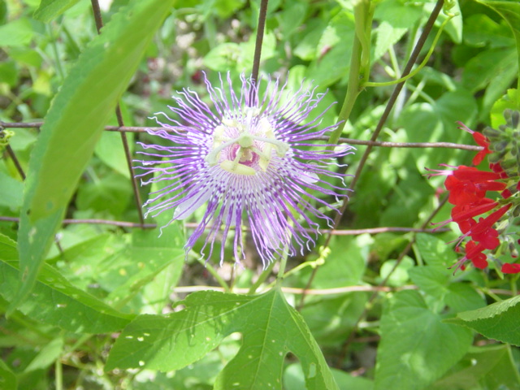
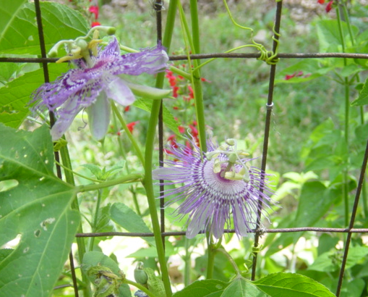
Hardy Passion Fruit
Passiflora incarnata aka Maypops, Vine Apricot
Tennessee State Wild Flower
Herbaceous perennial vine – somewhat stoloniferous – highly ornamental – fragrant -- medicinal -- edible

Slide 4
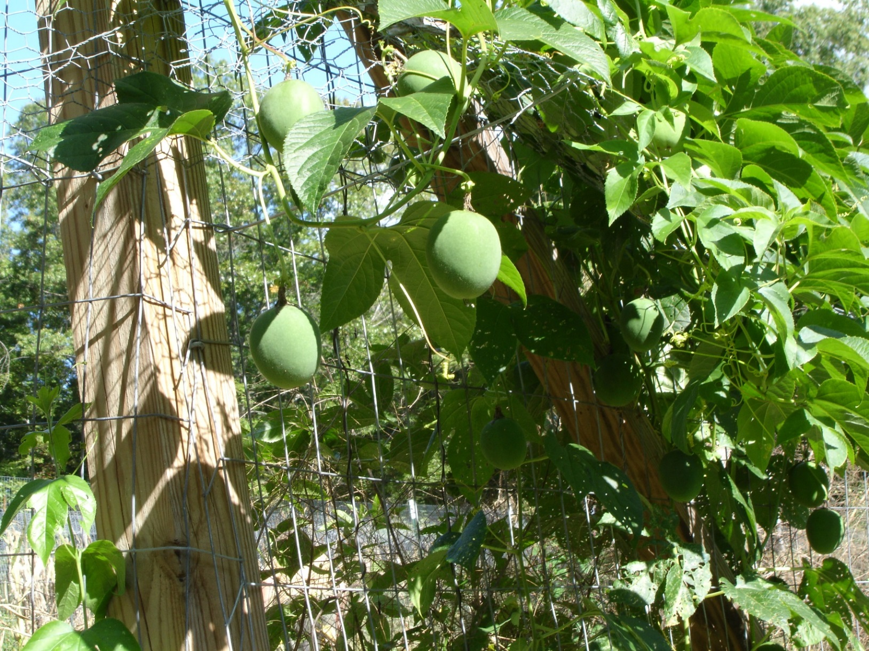
Vine, self-trellising (by tendrils) on garden fence with abundant fruit ripening late summer

Slide 5
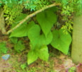
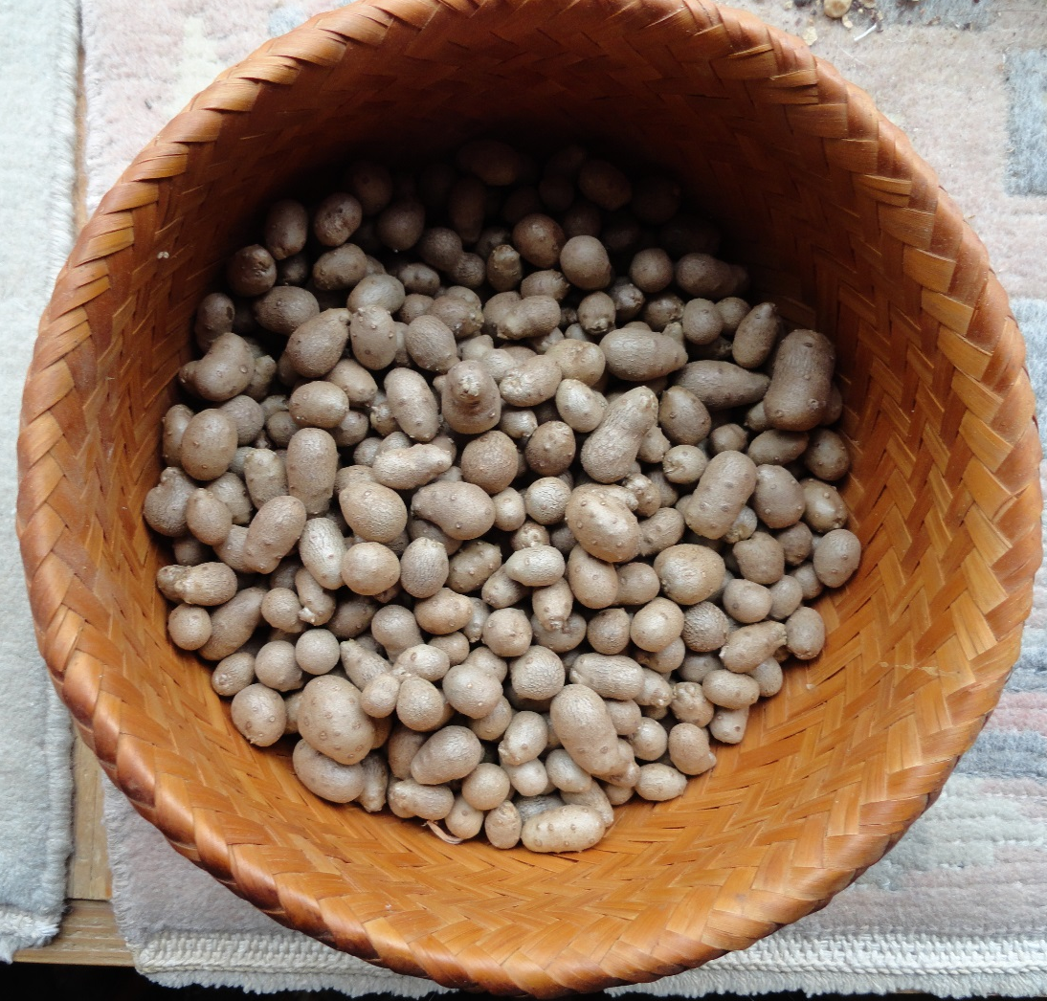
Air Potatoes
Dioscorea batatas
Hardy, perennial yam
Large underground tuber can be left for several years
Small aerial tubers produced annually at leaf axils on vine which dies back but only after leaves take on brilliant yellow color before falling.
Harvest is easiest by placing a sheet on the ground and shaking the vines.
Can be eaten raw or cooked – keeps well.

Slide 6
Chestnuts
Castanea species & hybrids known and used in Europe as tree potatoes
Not a true hard-shelled nut
In the same family as oaks and beech nut trees
Not a timber type tree like the American Chestnut, which is now pretty much gone, but makes a nut (fruit) of equal or better quality
Tree size similar to a full-sized apple tree
Freezes well
Can be used as a vegetable or roasted as a treat as in the song
Need two or more different clones for pollination
Annual bearing

Slide 7
Muscadine Grape
Vitis rotundifolia
Native to the Southeast
Immune to Pierce’s disease (a problem for wine grapes and some table grapes which can be grafted on Muscadine)
Heavy bearing once established
Many named cultivars available – purples & blacks highest in health promoting/protecting qualities
Ripening season September through October
Good fresh or cooked, makes excellent wine and the fresh juice freezes well

Slide 8
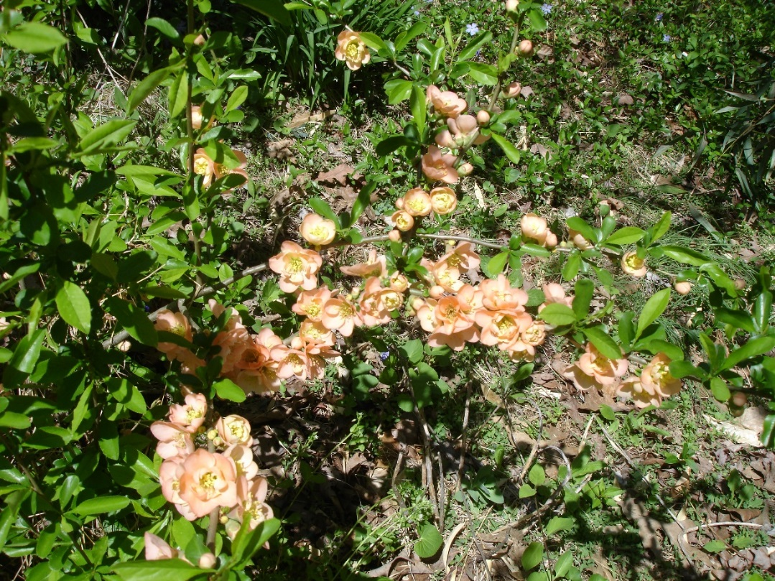
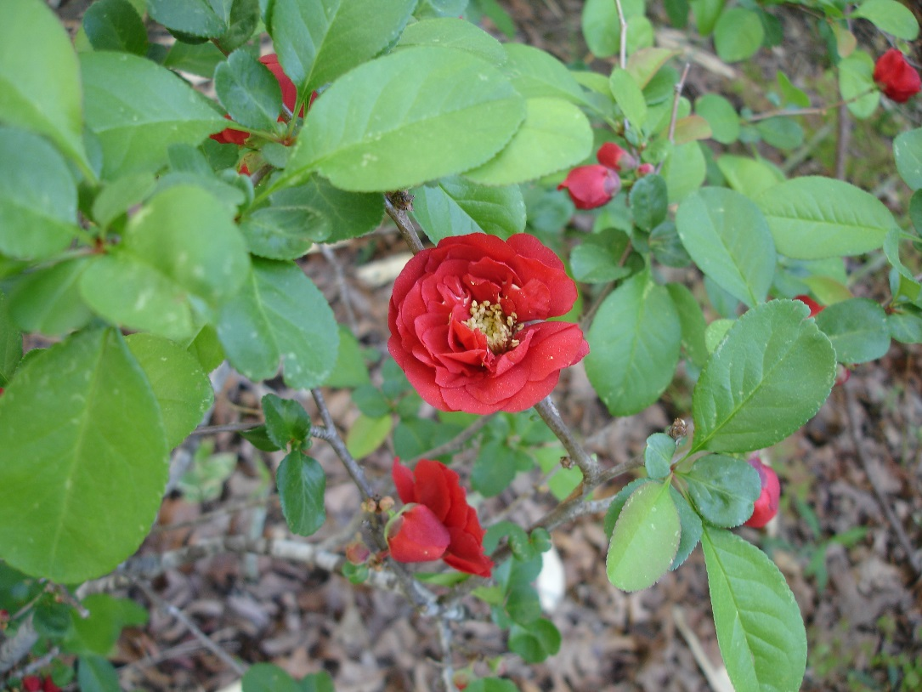
Flowering Quince
Chaenomeles species
‘Cameo’ Flowering Quince
‘Dragon’s Blood’ Flowering Quince
Suckering, woody shrub – early to very early flowering, fruit (cooking) 2-4” diameter -- three or four species in the genus but mostly hybrids (30 or so named cultivars currently available ranging in size <18” to nearly 10’ if unpruned) are used as they readily cross so seedlings can offer surprises

Slide 9
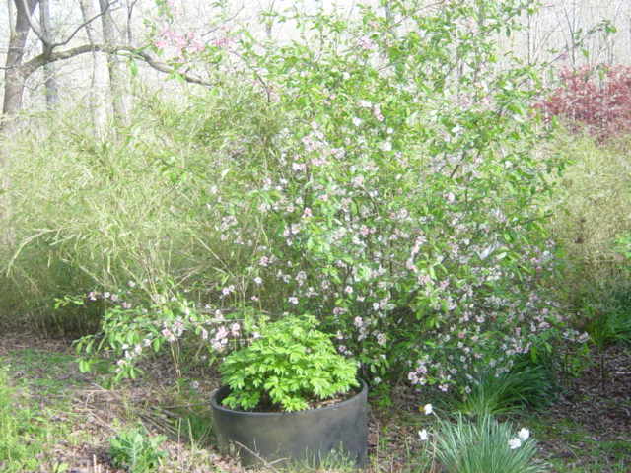
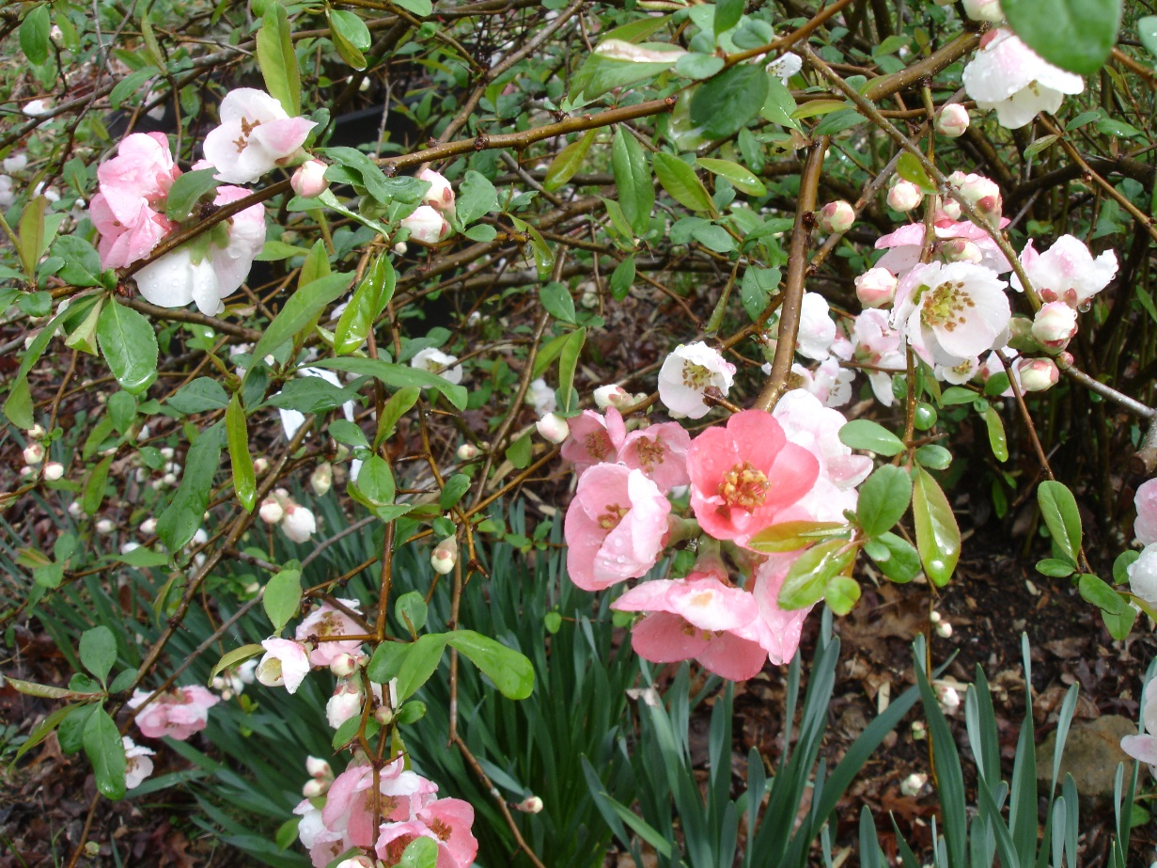
Chaenomeles– ‘Toyonishiki’
Left: mature shrub after 10 years – about 8’ tall and 10’ across (unpruned)
Right: Close up showing flower detail

Slide 10
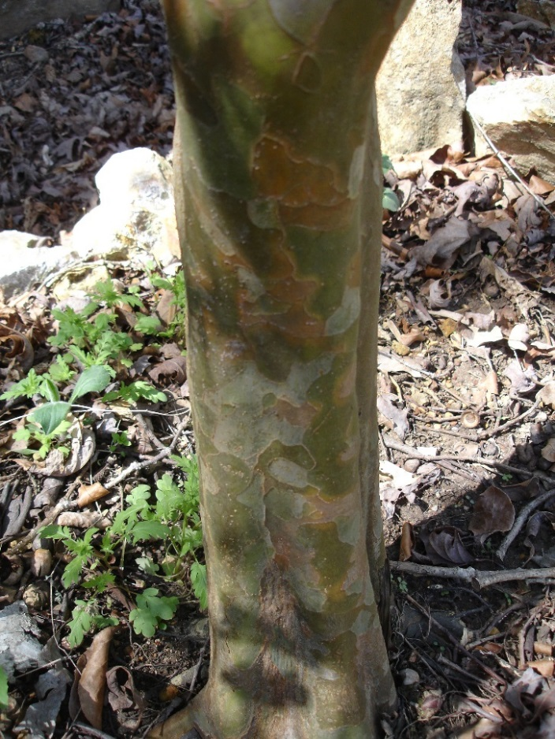
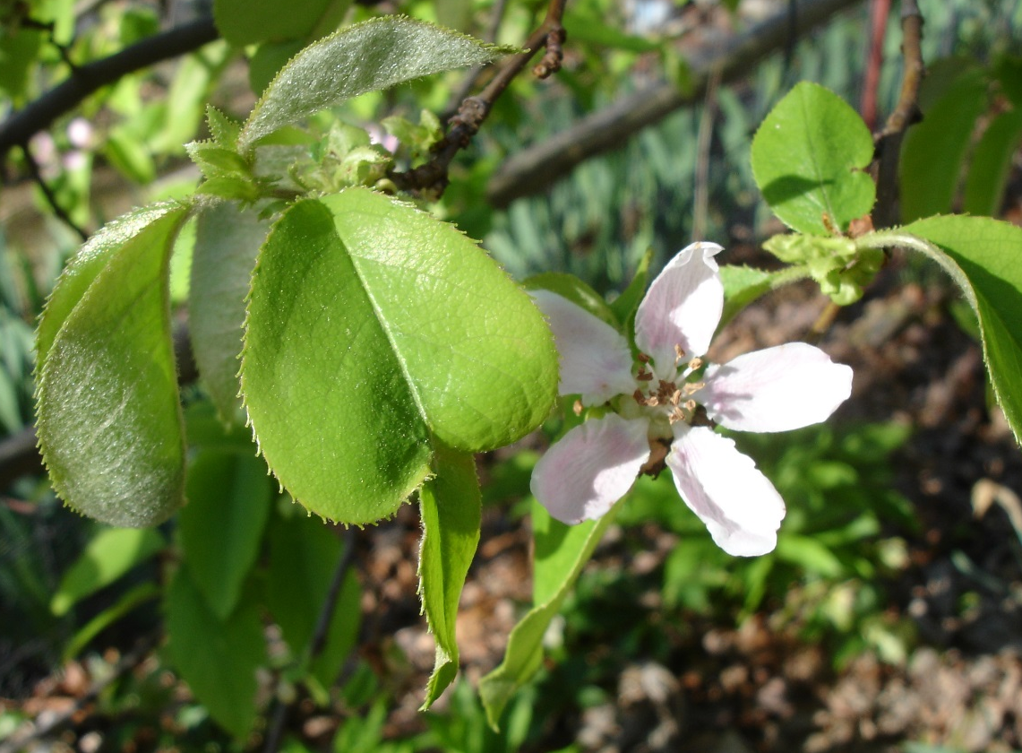
Tree Quince
Pseudocydonia sinensis
Exfoliating bark
Flower Close up

Slide 11
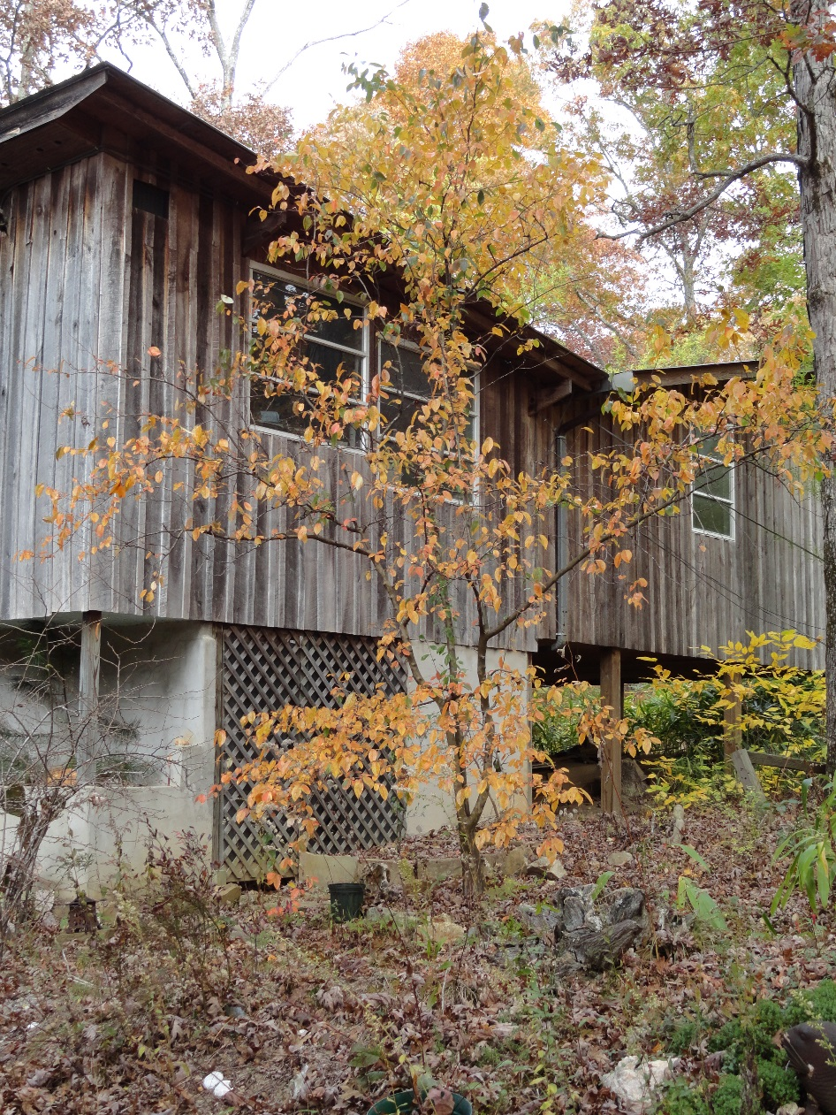
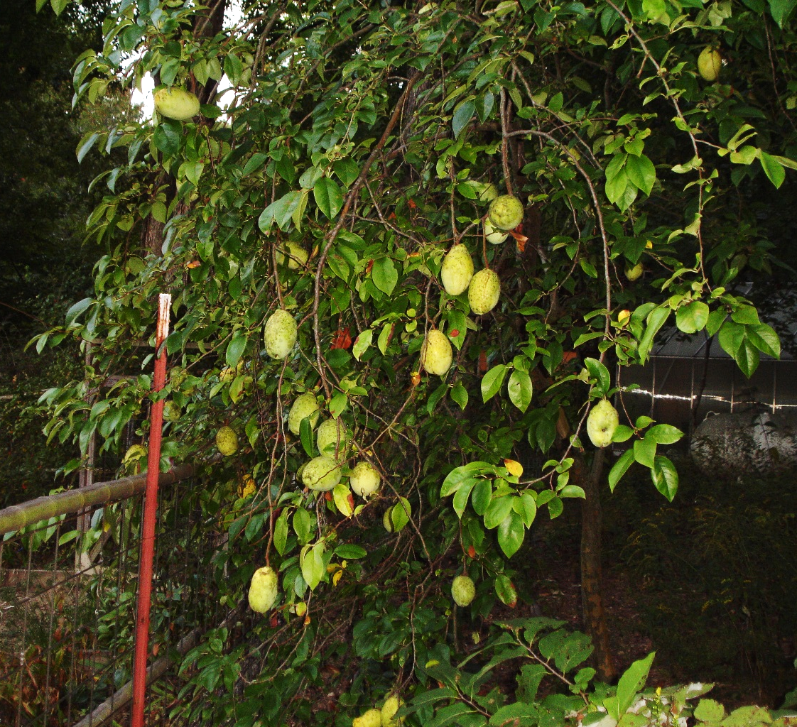
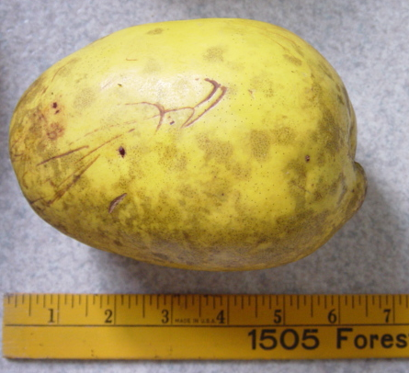
Native to Central China – does well in middle Tennessee – no observed pests or diseases – delicious fruit cooks up pink -- can reach 3 lbs -- high in antioxidants and phytonutrients – keeps for several months
Fruit hanging on tree – Above
Actual fruit size (6 ½”+) - Right
Tree form showing fall color

Slide 12
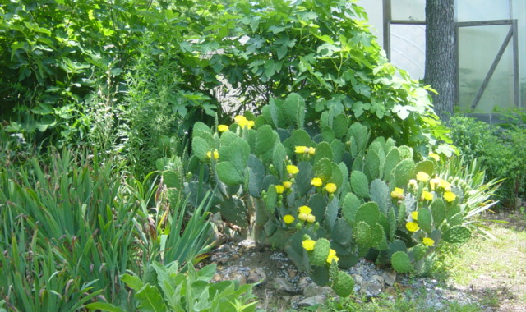
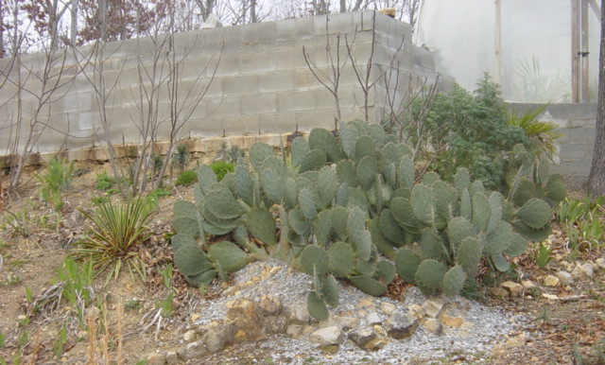
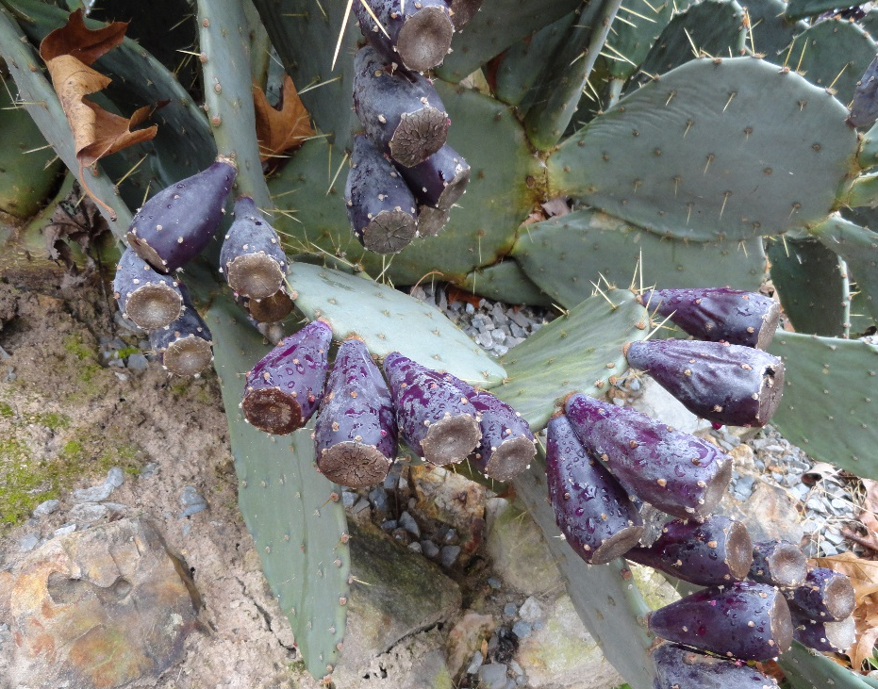
Hardy Cactus
Opuntia englemanii
Hardy to at least 0°F. (with proper siting – needs immaculate winter drainage) Of the 30 or so species we have trialed, this is the most productive of both tasty edible pads (Nopales) and sweet/tart fruit (Tunas) – the flowers ain’t bad either

Slide 13
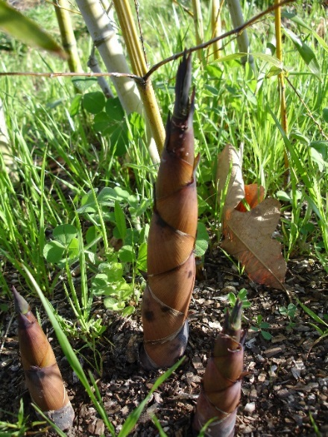
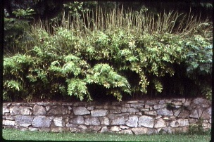
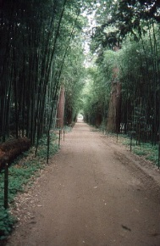
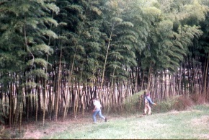
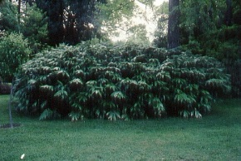
Bamboo
For 30+ years, a major part of our research. All bamboos produce edible shoots, flavor varies with species and season. Woody canes used for anything that can be done with tree wood. Stronger than mild steel by weight. Also excellent animal fodder and makes a healthy tea. Many species evergreen to 0°F. or below

Slide 14
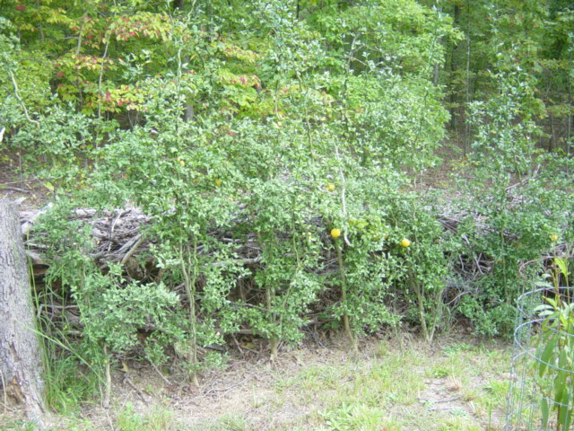
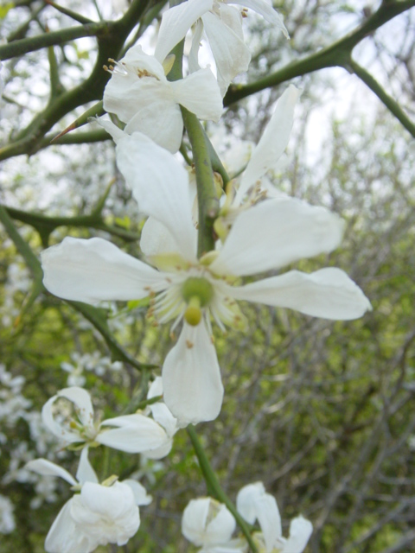
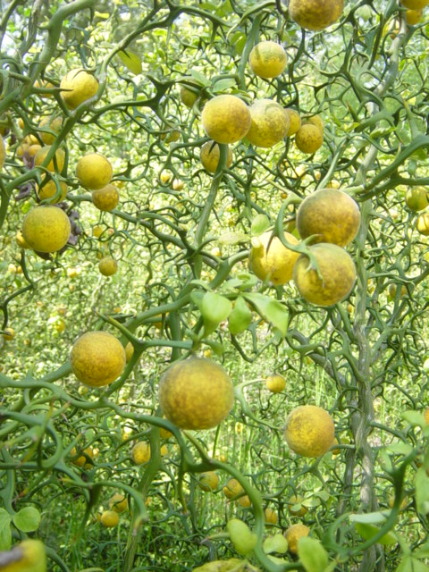
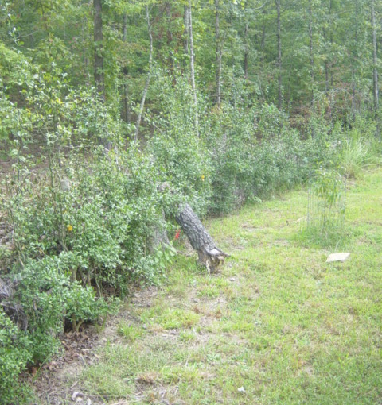
Hardy Citrus
Poncirus trifoliata ‘Flying Dragon’
Top & bottom left: Hedge, Middle: Fragrant flowers in spring,
Right: almost ripe fruit in the fall. Note the hooked thorns which provide a dramatic winter profile. When hedged, makes an impenetrable barrier for people or deer. Monospecific genus native to Central China makes food, security and beauty and is hardy to -17°F.

Slide 15


Slide 16
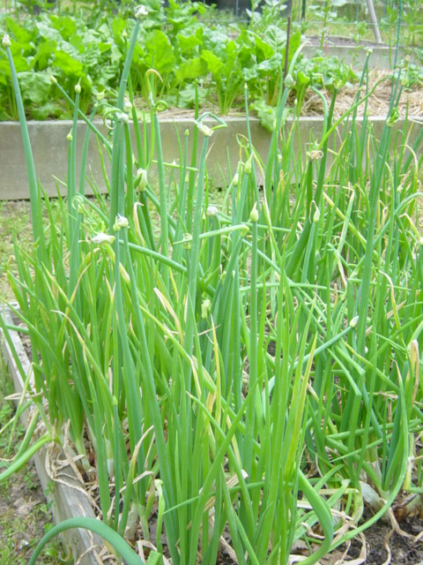
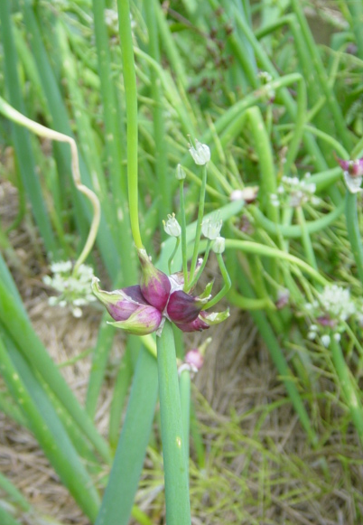
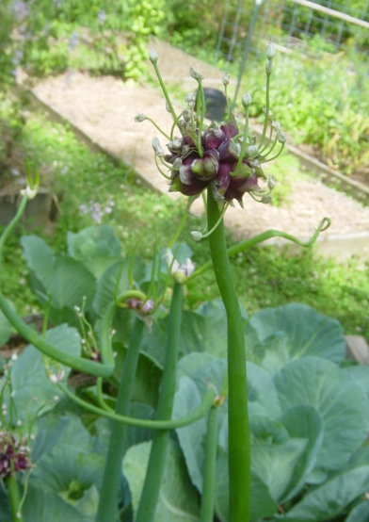
Egyptian Onions
Allium cepa aka walking onions, tree onions
Top: Cluster w/top sets just beginning to bulb. Right: flowering and bulbils forming. Good companion for roses, top bulbils are harvested annually, bottoms divided every 3 or 4 years of when congested. Keeps well.

Slide 17
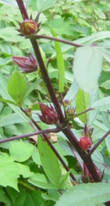
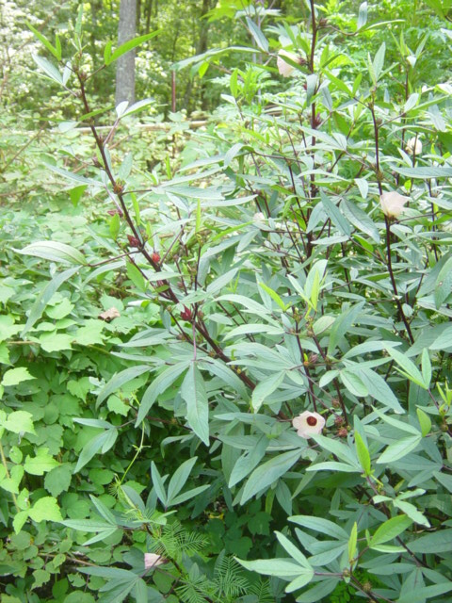
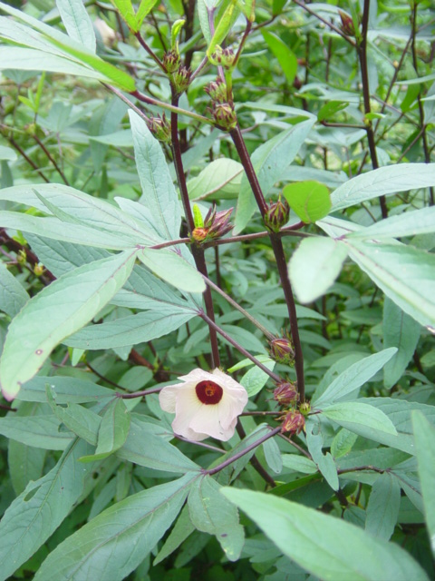
Jimaca (Jamaican Sorrel, Roselle)
Hibiscus sabdariffa
A beautiful okra relative - perennial in the tropics or a warm greenhouse - grown as an annual here outdoors. The source of sour leaves used in Caribbean cooking & the dried or fresh sepals are the basis for the famous Red Zinger tea.

Slide 18
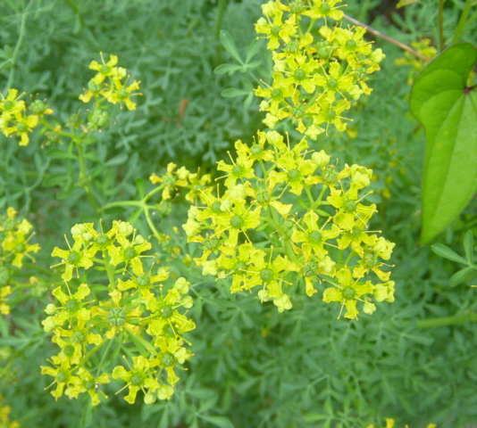
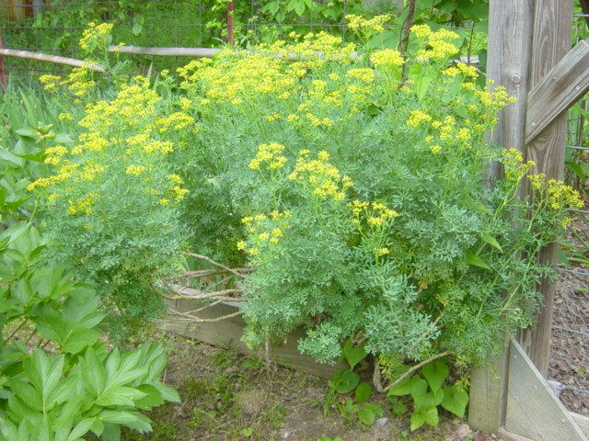
Rue
Ruta graveolens aka Herb of Grace
Attracts beneficial insects – is said to repel rodents, rabbits, etc. – unusual looking blue-green foliage year-round – flowers in early summer – hosts some rare butterfly larvae in the fall. Cuttings strike readily, comes true from seed – used medicinally for indigestion – very bitter taste but leaves a clean palette.

Slide 19
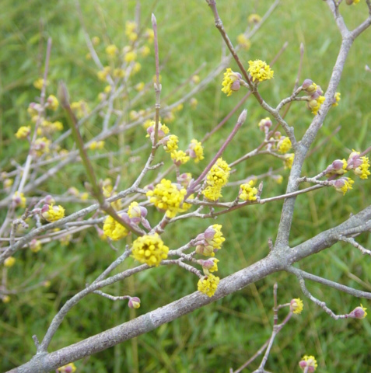
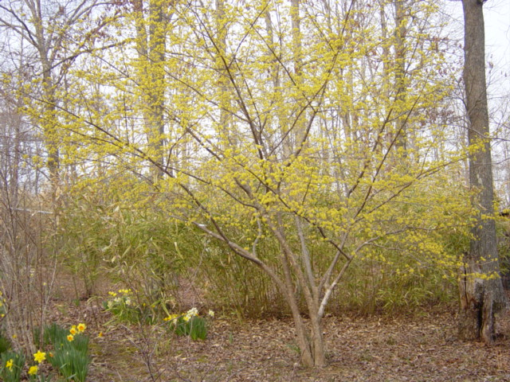
Cornelian Cherry
Cornus mas
One of the earliest flowering small trees – usually March – related to our native dogwood but lacks the large white bracts around the flowers. Fruit – 1 to 1 ½” long, single seeded, deep maroon when fully ripe – no apparent pests other than competition from local wildlife. We like it better than cherries (Prunus) and eat it both out of hand and in pies – makes an excellent wine or can be canned as a syrup – high in desirable phytonutrients. Native to central Europe where it is a major fruit in local markets. Likes a hot, dry location – trouble free.

Slide 20
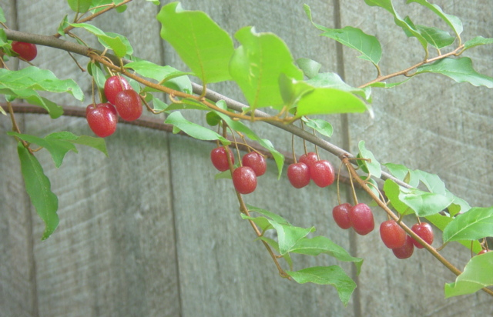
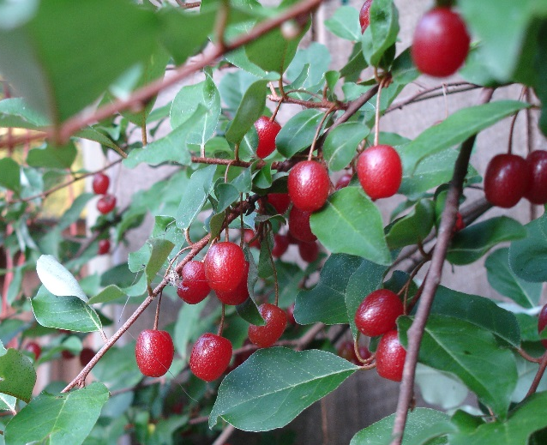
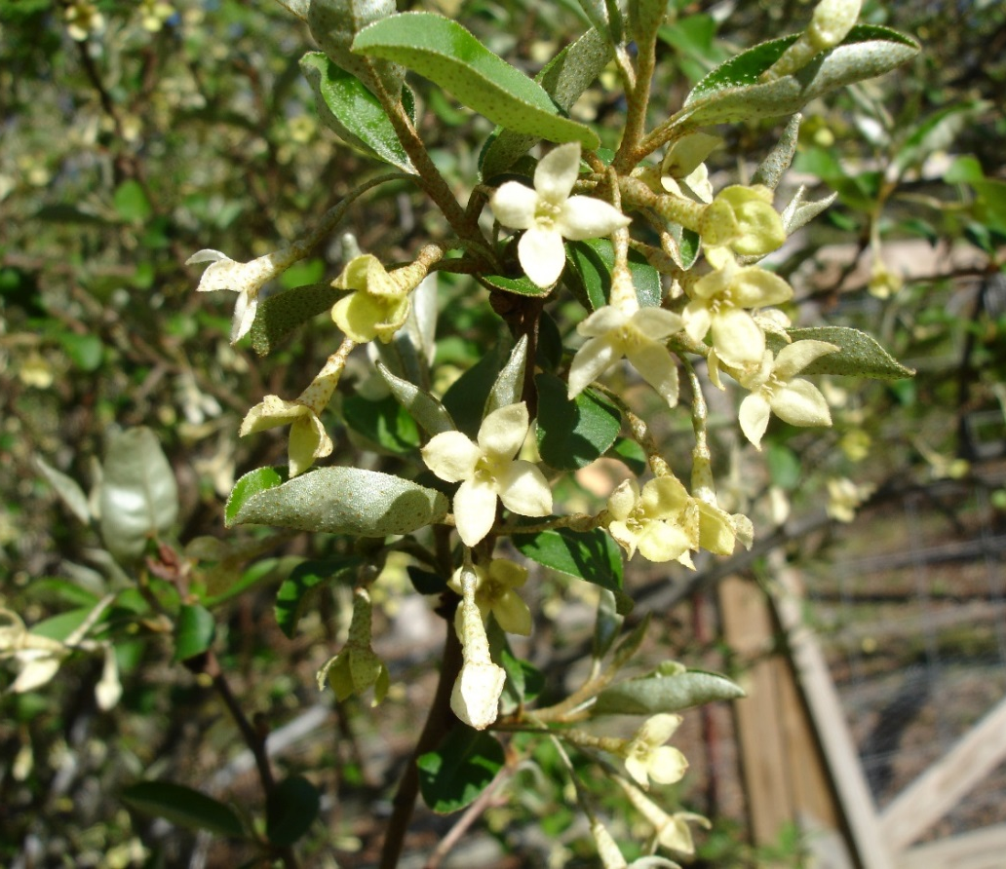
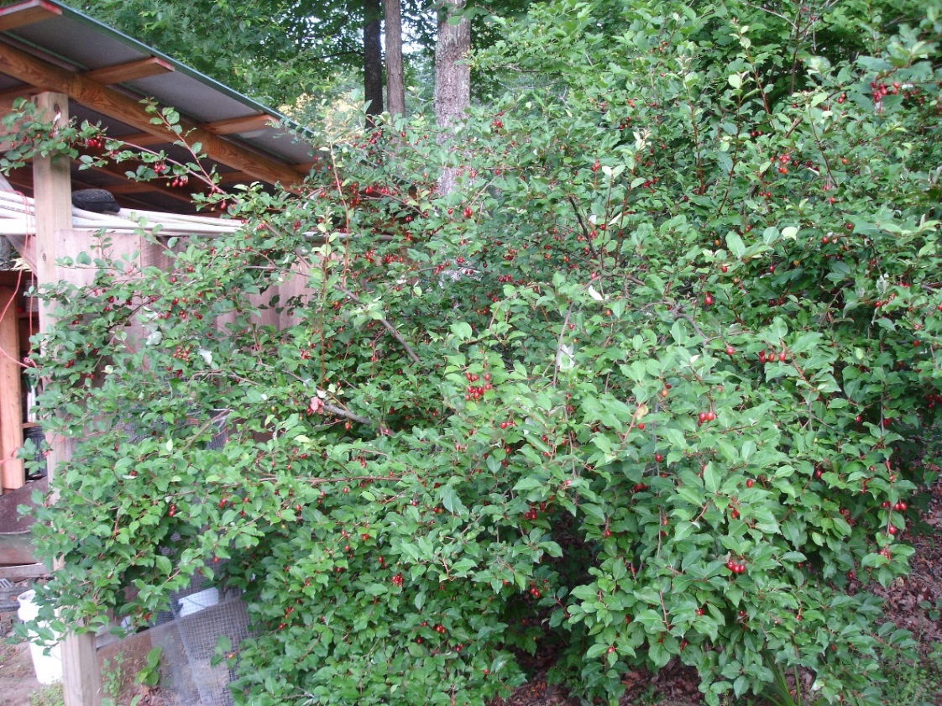
Goumi
Eleagnus multiflora
Nitrogen-fixing shrub, fragrant flowers are good bee pasture, Japanese native, trouble free, 10’ tall, 20’ across after 15 years (unpruned). Fruit high in anti-oxidants and other phytonutrients. Use fresh or for jam or syrup.

Slide 21
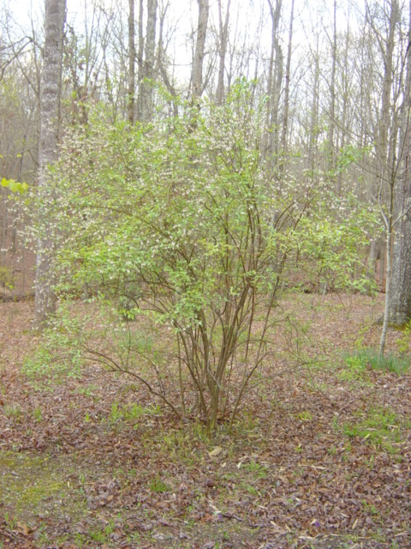
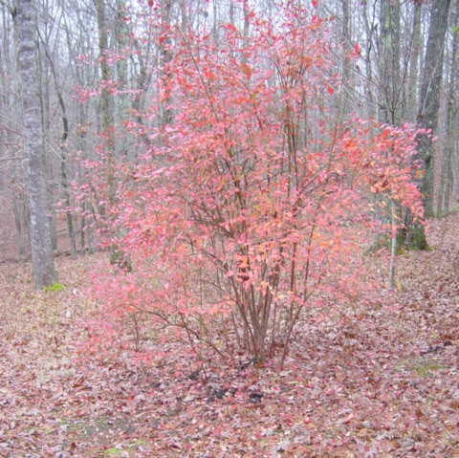
Blueberries
Vaccinium ashei aka Rabbit Eye Blueberry
Native to the Southeast – later bearing than highbush types but better adapted to our roller coaster weather including sometimes hot, dry summers. Unpruned – 10’x 10’ – easily managed – pests and problems insignificant. High in antioxidants and other phytonutrients – one of the healthiest foods not to mention tasty.
Tifblue Blueberry -- blooming
Tifblue Blueberry – fall color

Slide 22
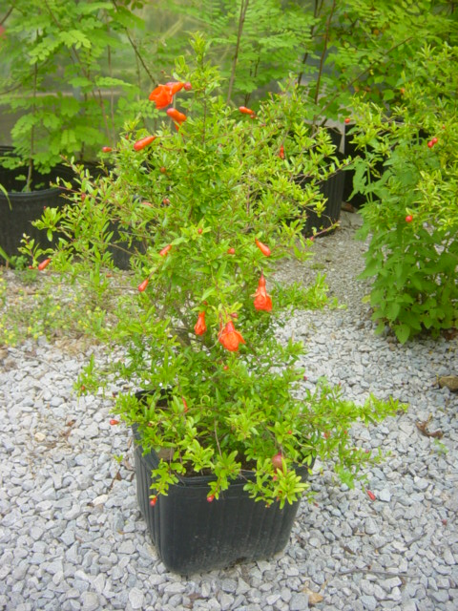
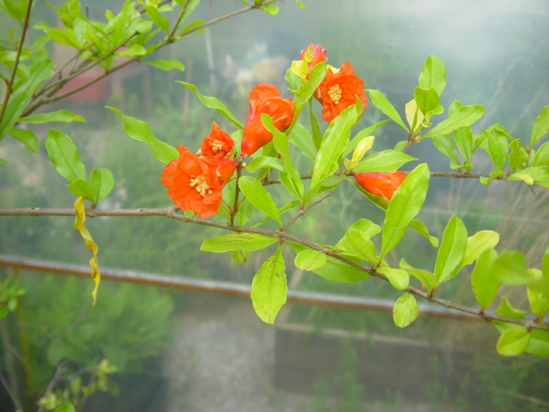
Pomegranate
Punica granatum
Turkmenistan native – shrub or small tree to 15’ unpruned – frost tolerant to 10°F – only one species but many cultivars – can be grown and fruited in middle Tennessee with suitable microclimate – many health promoting antioxidants and phytonutrients -- flowers also edible not mention unusual and beautiful. Name translates: apple of Granada.

Slide 23
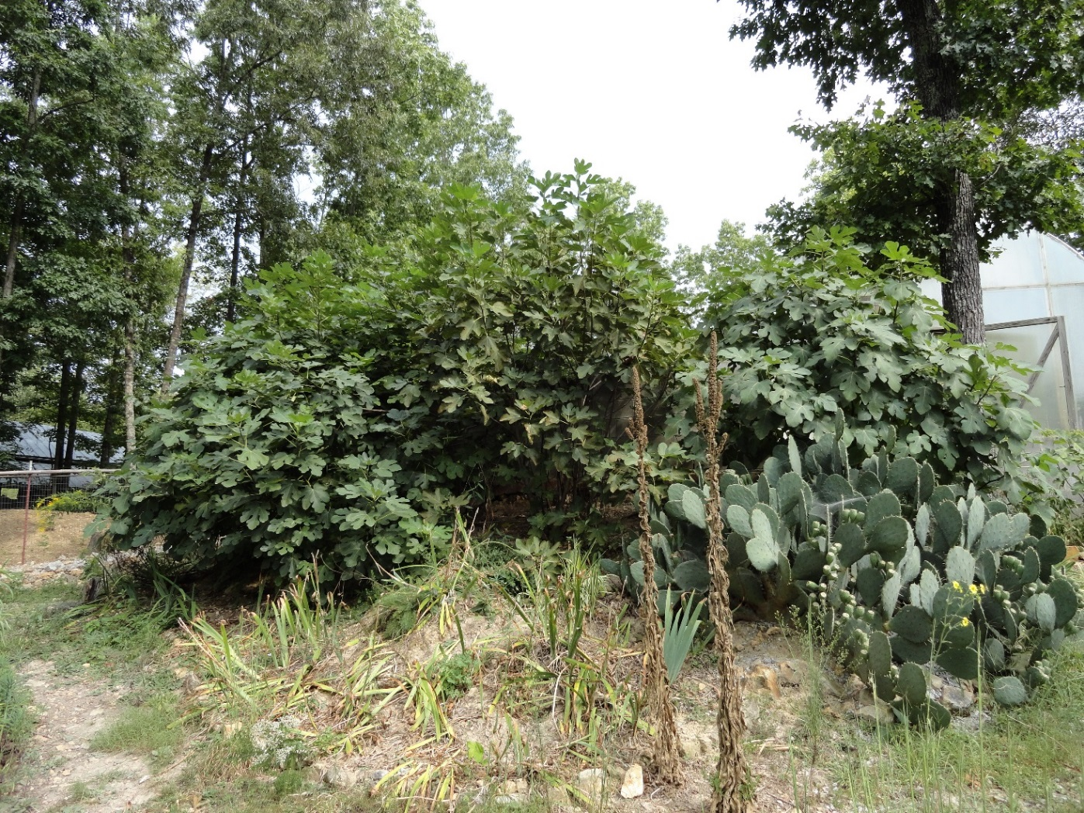
Figs
Ficus carica
Native to hot dry areas of the Near East
Everbearing types do well in middle Tennessee with microclimate siting
Hardy to 5°F but will regrow from the roots after an extreme winter
Many cultivars available, all self fertile
Fruit color can be yellow, green, brown, purple, black or striped
Size can range from one to 3”
Can be pruned to any size or shape

Slide 24
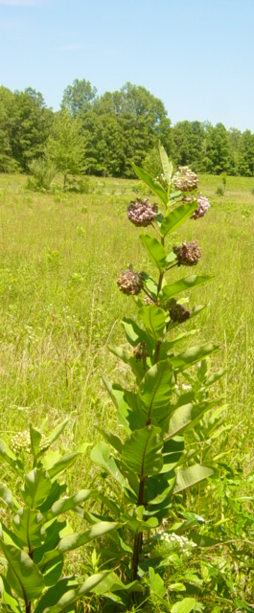
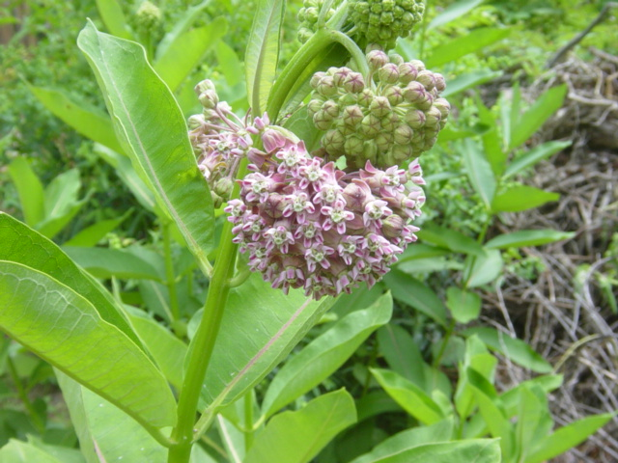
Milkweed
Asclepias syriaca
Somewhat stoloniferous
Multi-use (food, beauty, fragrance, fiber and potential rubber source
Host to monarchs
Our favorite cooked green – use two waters – does not cook down to mush
The first plant we established when we bought our current farm in 1991

Slide 25
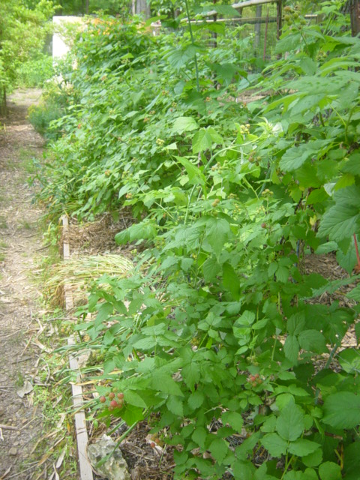
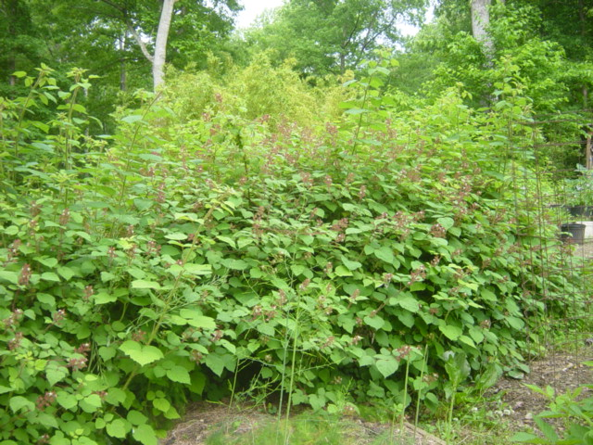
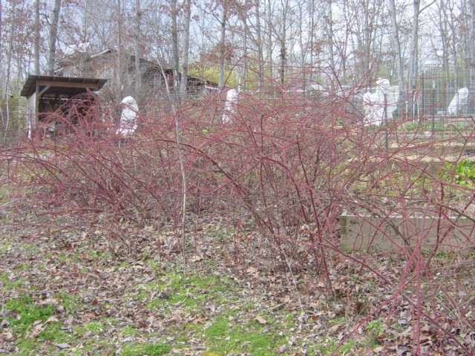



Cane Fruit (Berries)
Rubus sp.
Left: hedge native black cap raspberries (Rubus occidentalis), Below Left: fruit ripening.
Right: Chinese wineberries (Rubus phoenicolasius) in flower, Below Right: fruit ripening.
Below: maroon canes provide winter interest.

Slide 26
RESOURCES
J.L. Hudson Seedsman – ethnobotanical seeds, catalog. No phone -- address: P.O. Box 337, LaHonda, CA 94020; web site: www.JLHudsonSeeds.net
Forest Farm – offers starter plants in huge diversity of potential candidate species – catalog. Phone: 541-846-7269; Web site: www.forestfarm.com
Tripple Brook Farm – ditto but smaller company & located in the East, on line catalog. Phone: 413-527-4626; web site: www.tripplebrookfarm.com
Oikos Tree Crops – diverse seed grown fruits and nuts for people and wildlife, catalog Phone: 269-624-6233 web site: www.oikostreecrops.com
North American Fruit Explorers (NAFEX) – quarterly member generated magazine, one three day annual meeting – varied venues. http://www.nafex.org
Northern Nut Growers (NNGA) – newsletter, annual meeting. Web site: www.nutgrowing.org
Southern Fruit Fellowship (SFF) – a regional, independent spinoff from NAFEX – newsletter, lots of field trips, annual meeting. Web site: www.southernfruitfellowship.com

