Slide 1
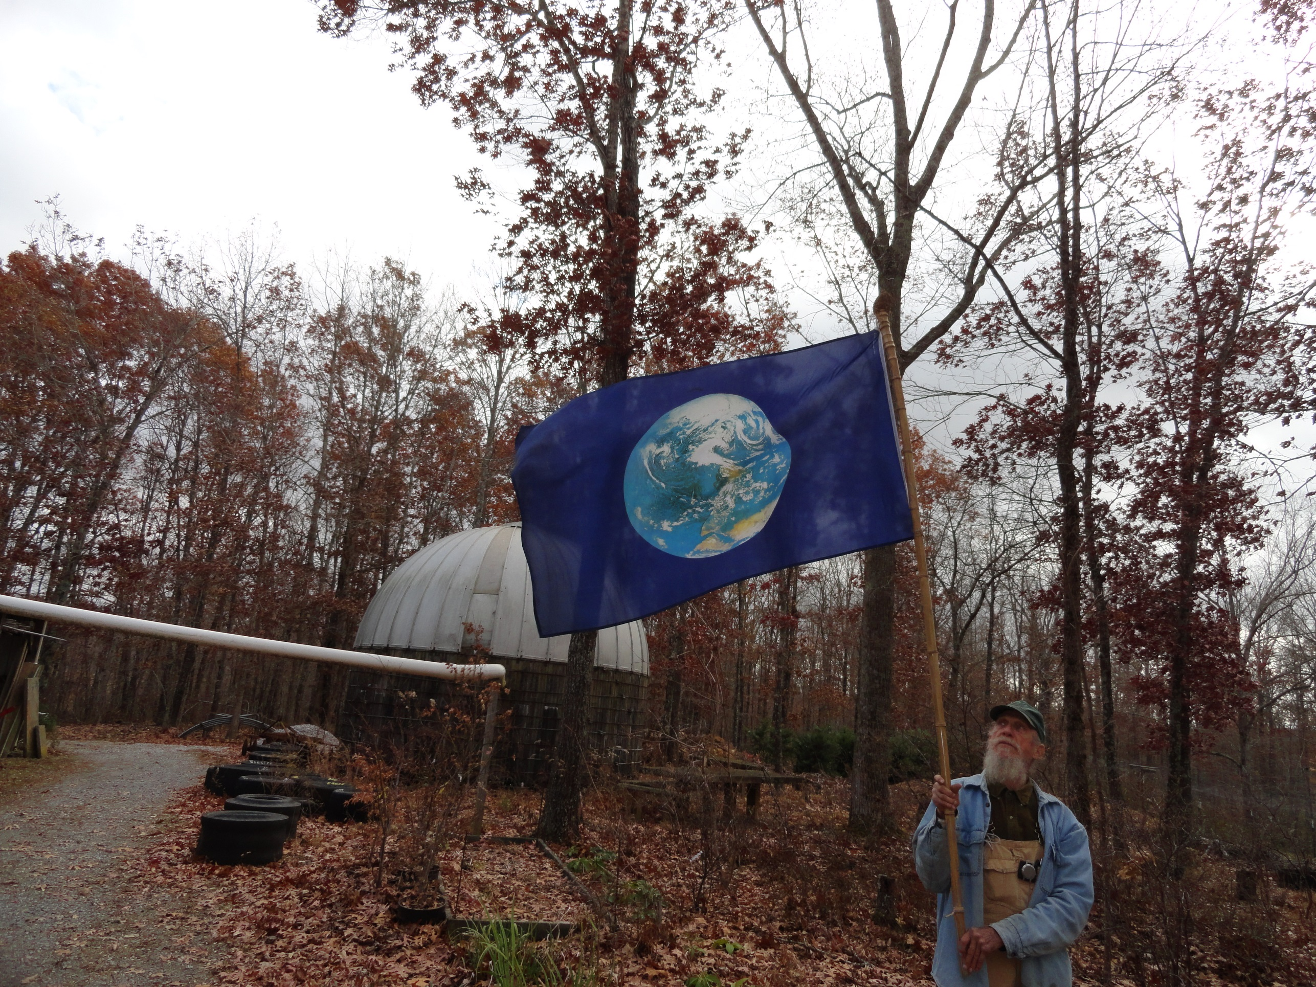
Evolving Year-round Home Food Production and Self Reliance
  By Adam & Sue Turtle of Earth Advocates Research Farm near Summertown, Tennessee
  Prepared for 2014 Nashville Local Food Summit, Vanderbilt University

Slide 2
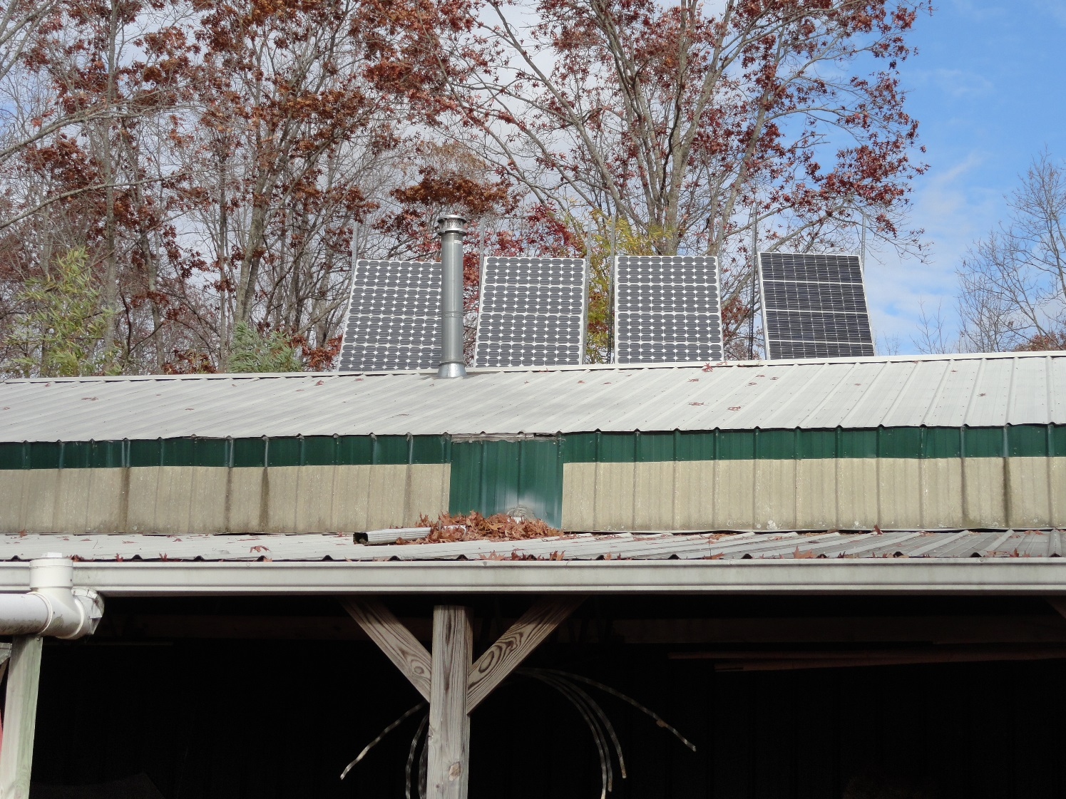
16 Panel Photovoltaic Array in Winter Position

Slide 3
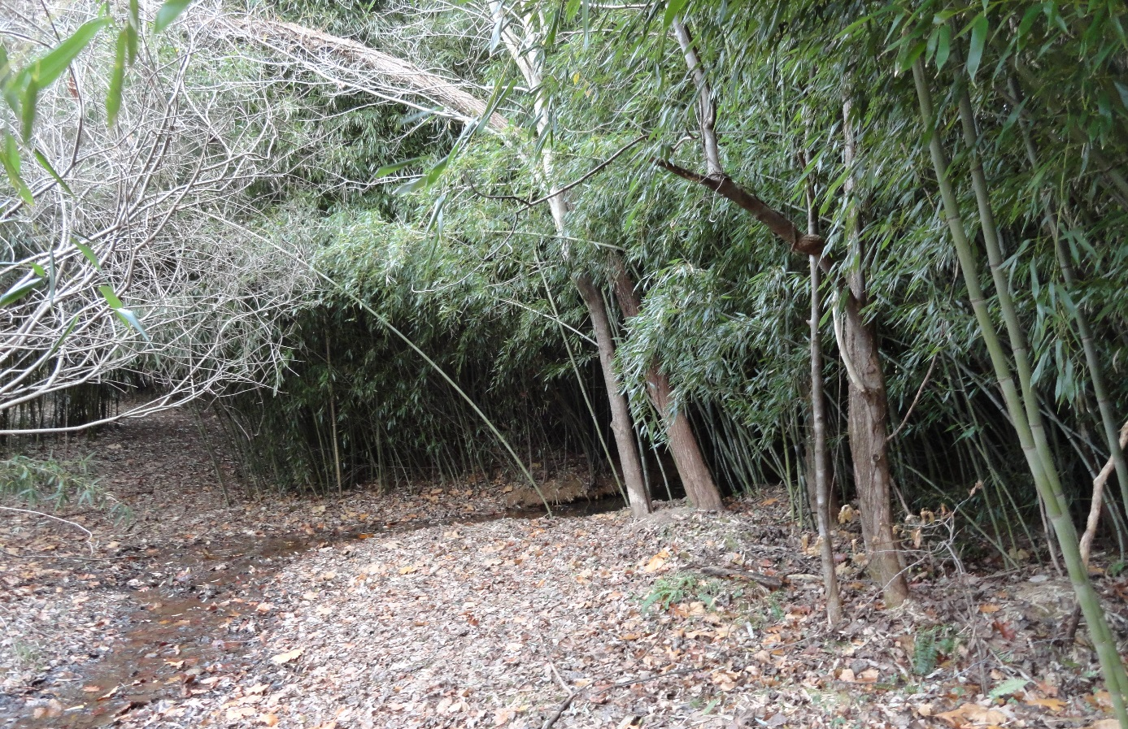
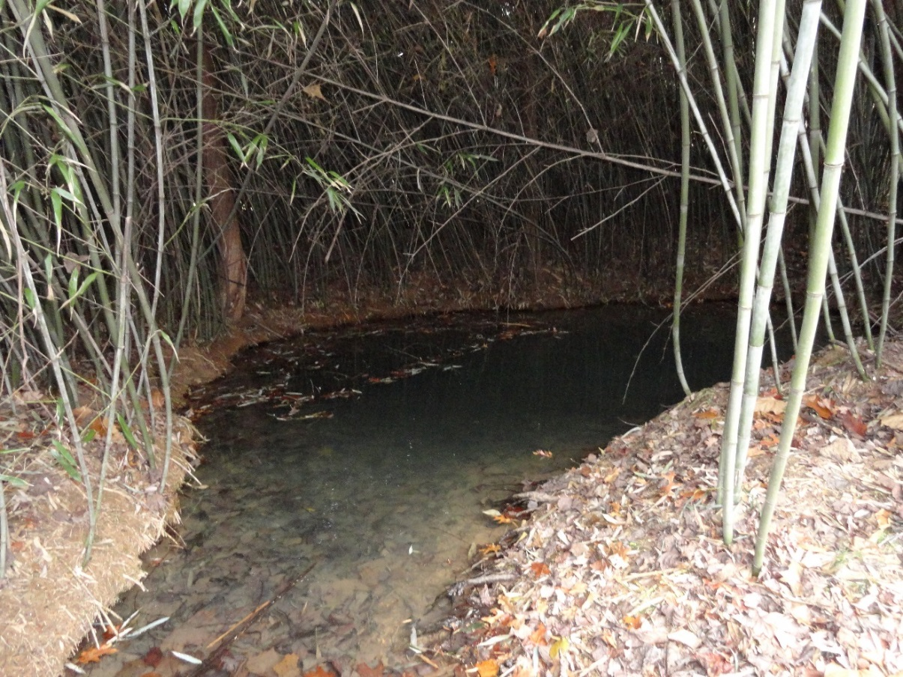
Sweet Water Spring
Bermed to prevent overland contamination
Planted with bamboo for shade to avoid algae

Slide 4
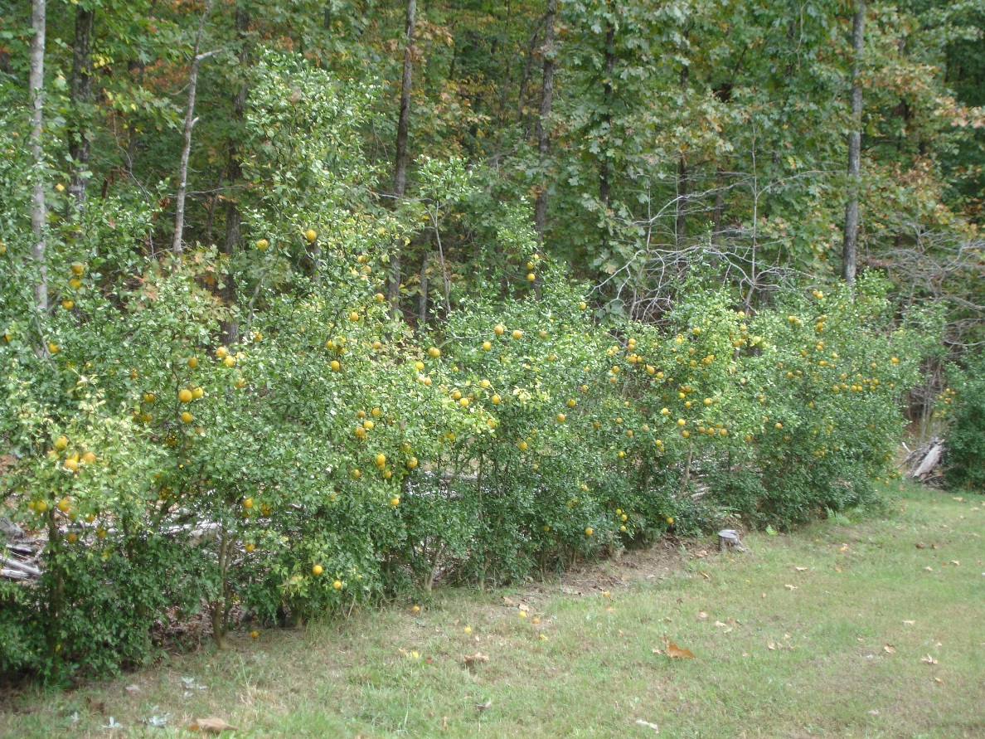
Fruit-producing, deer-proof hardy citrus hedge
Poncirus trifoliata ‘Flying Dragon’

Slide 5
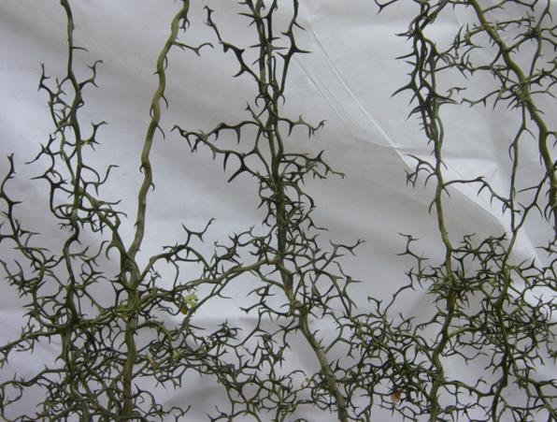
Our Ad as seen in Acres, USA
& The Permaculture Activist
GROW YOUR OWN
(VERY) BARBED (NON) WIRE
deer & Personnel proof – usda zone 6 & up
www.earthadvocatesresearchfarm.com
931-964-4151

Slide 6
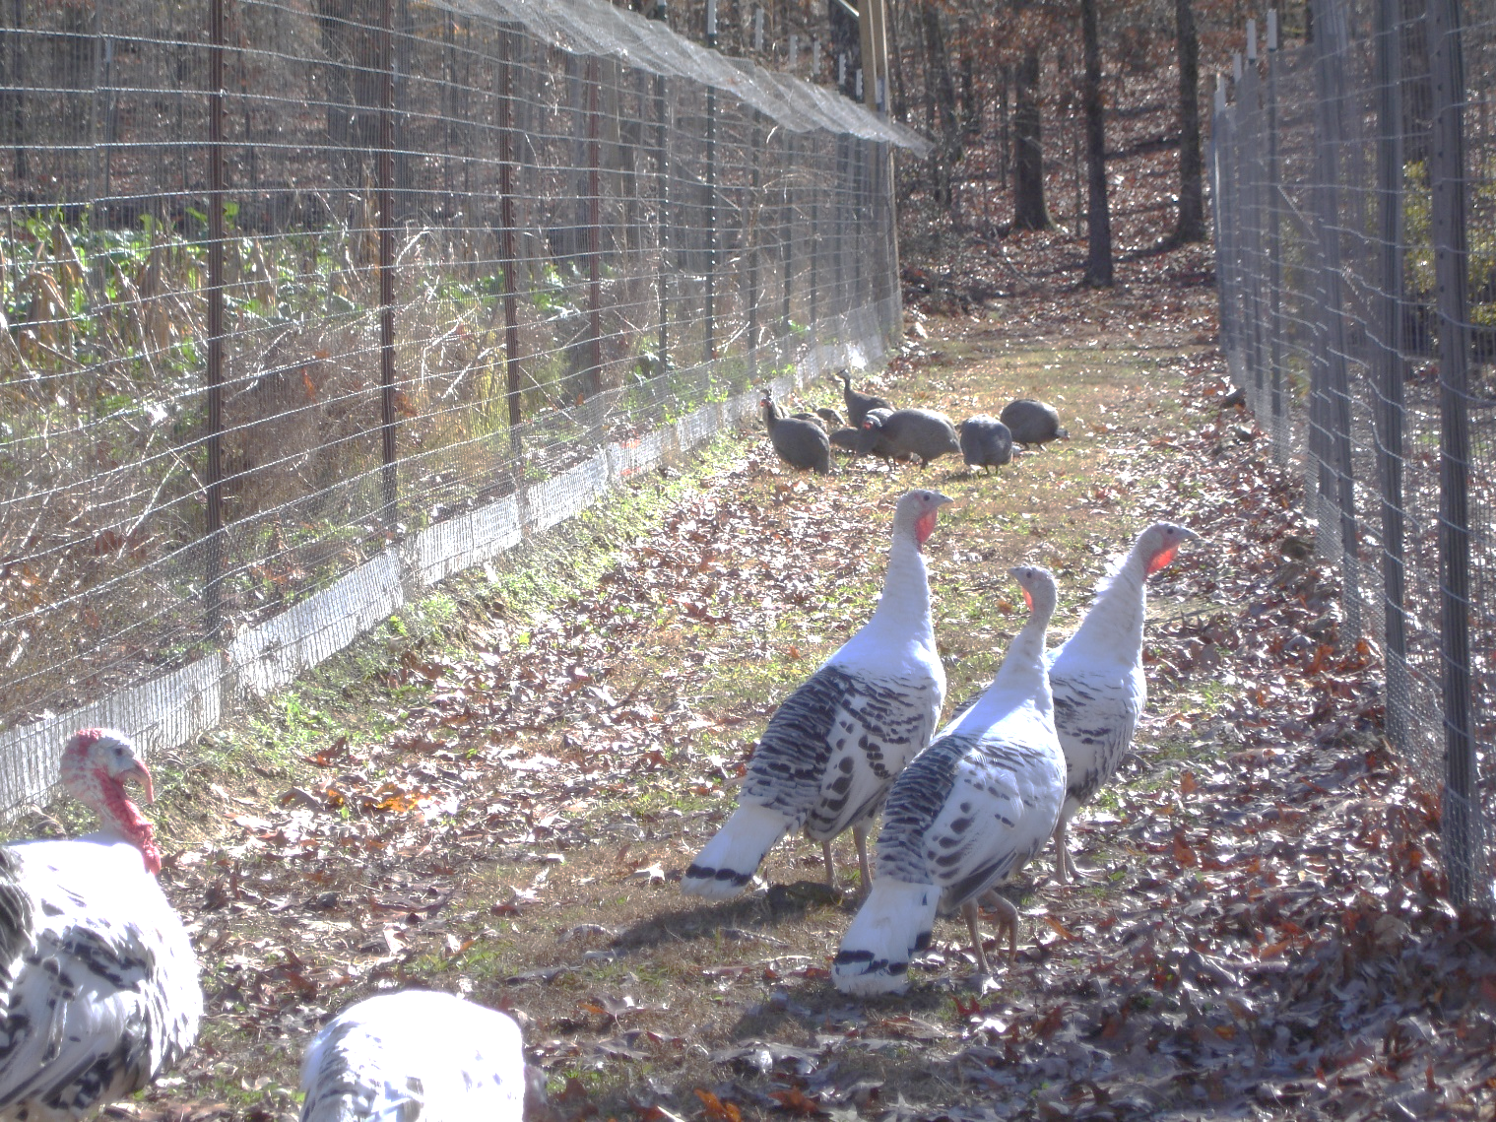
Garden Fencing
Composed of 6 foot, 2”x4” welded wire with bottom 6” buried, span supported by T-posts, corners of treated 4”x4” with bracing. 18” x 1” mesh chicken wire is hog-ringed onto the bottom against small animal entry. Also, hog-ringed at the top with New Zealand high-tension hold offs creating a “ceiling” to prevent climbers (coons) access.
It works! We can grow sweet corn now!

Slide 7
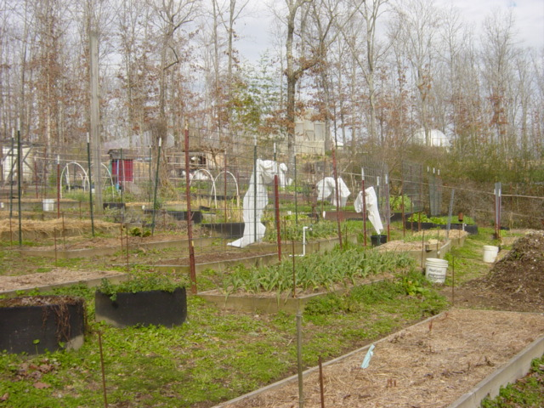
Our main kitchen garden of various raised-bed planters. Note frost blankets hung on trellises between uses in the winter. Folded and put away during the off season.

Slide 8
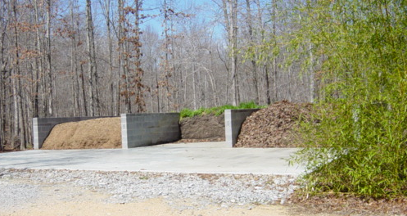
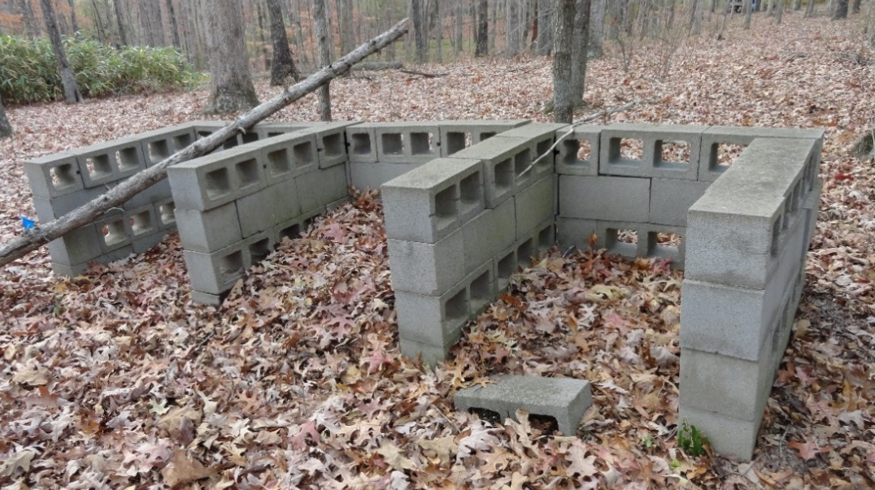
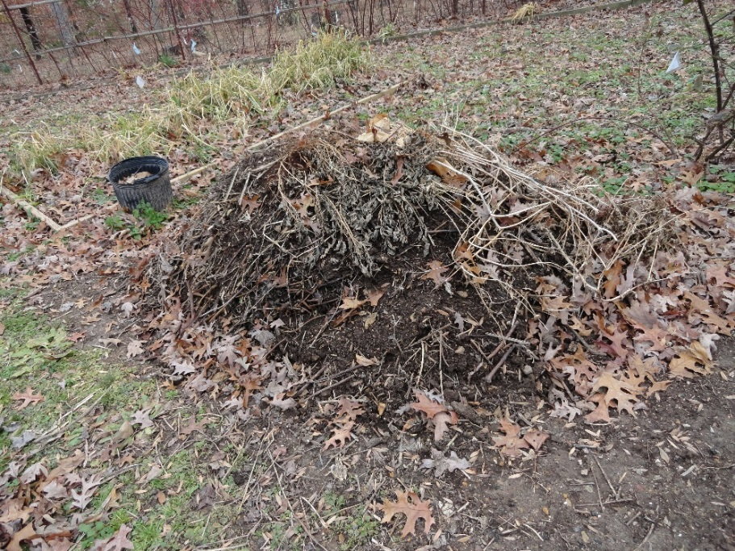
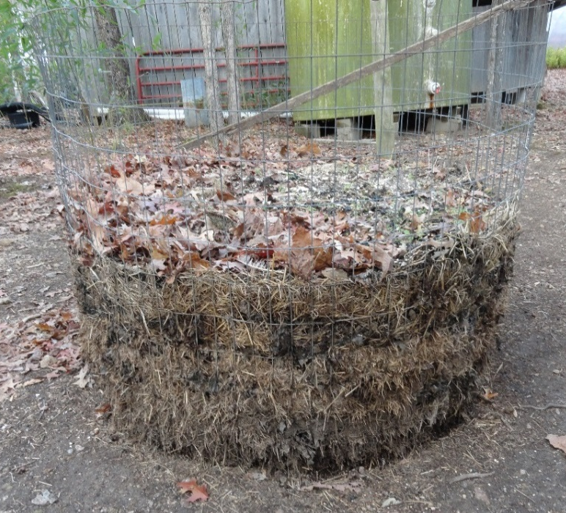
Above: Main compost with three 12’ x 20’ bins
Above: Household compost with three 3’ x 4’ bins
Left: in garden compost pile of plant wastes, machete chopped and hand turned.
Right: Chicken & Rabbit manures composted with their bedding in a bin of 4’ tall 2 x 4 welded wire.

Slide 9
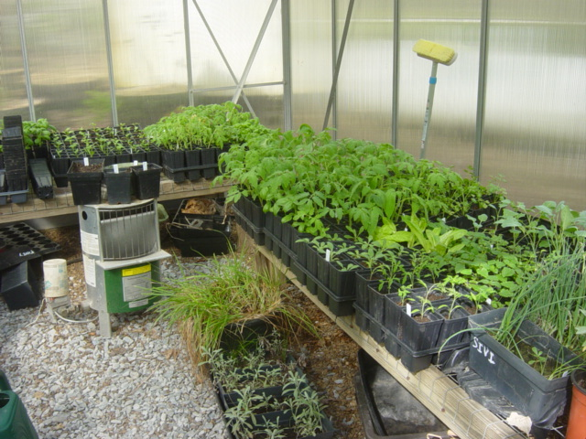
Spring Seed Starting in a Heated Greenhouse for season extension

Slide 10
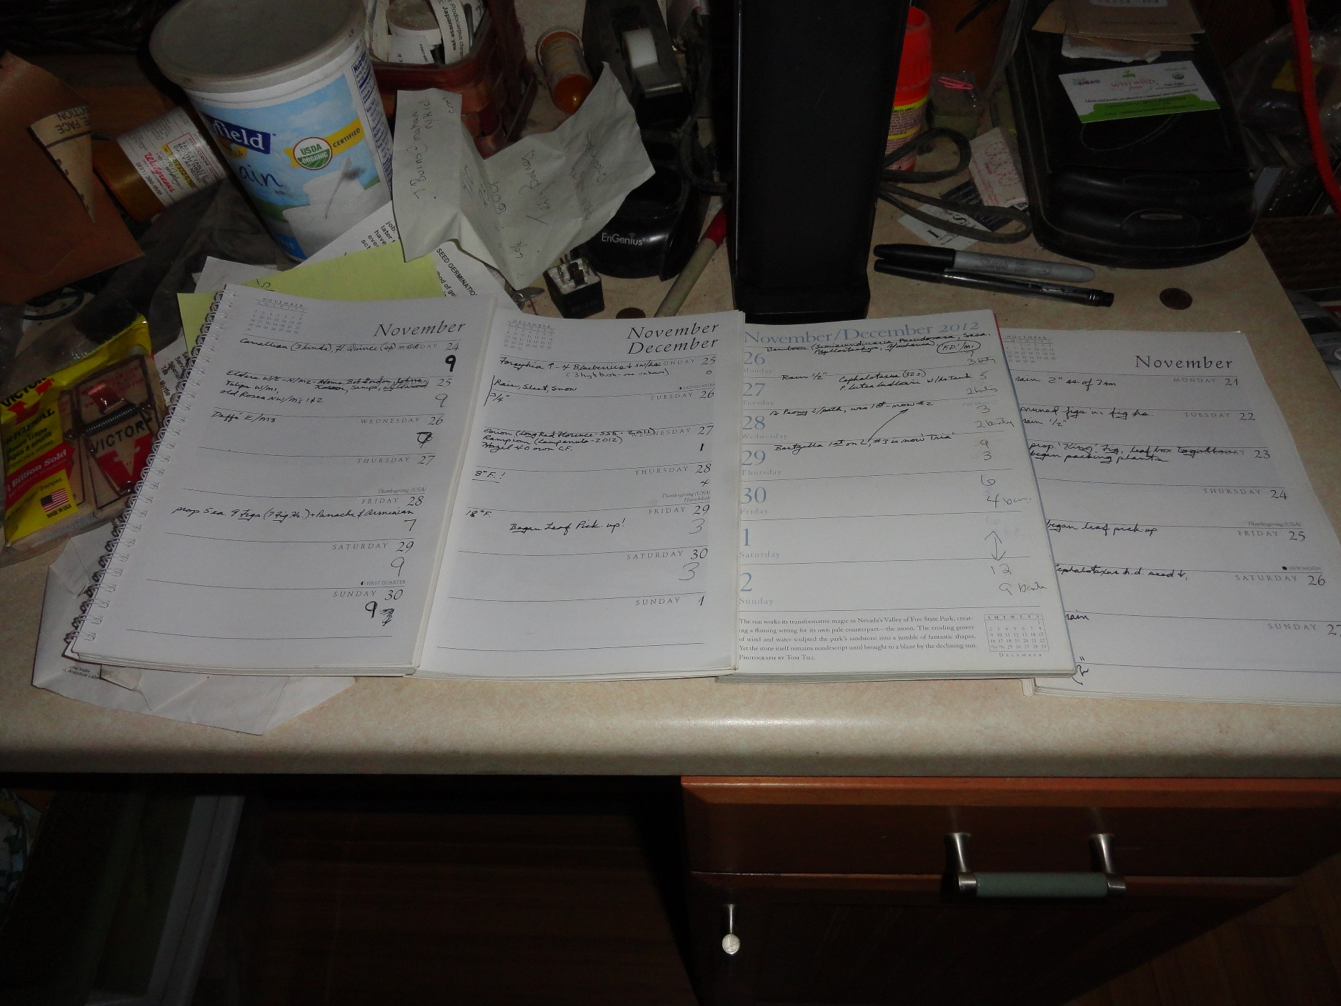
We keep current and three previous years of garden diaries on the kitchen counter. Each day’s doin’s are entered and on Sunday night when I turn the pages, I look back over previous years as a memory jog and to compare timing. Rain/snow totals and any notable temperature events are also entered.

Slide 11
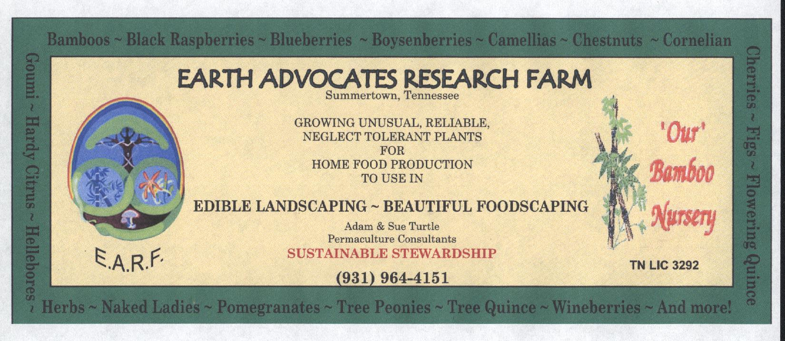
Our 3’ x 5’ banner shows who we are, what we do and some of the plants we grow.

Slide 12
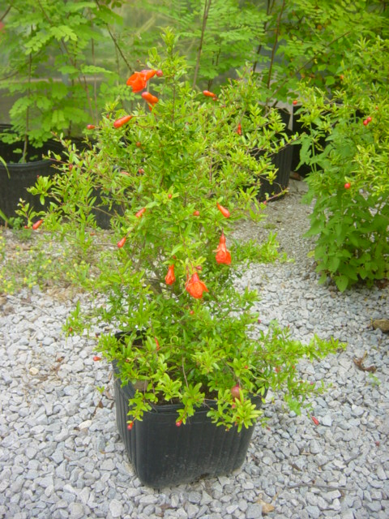
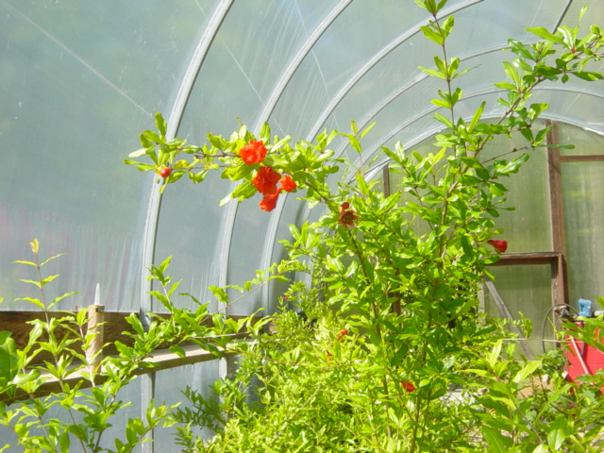
Pomegranates – Punica granatum
While only rated hardy to +10°F., with careful siting in a microclimate they are currently possible in middle Tennessee – with global warming who knows. We’ve been fooling with them for a little over 5 years and currently have about 30 named cultivars under trials as well as over 100 seedlings. We’ll let you know how it turns out.
We will continue our trials hoping eventually we’ll come up on a cultivar better able to handle our conditions. So far, they are still somewhat experimental, but fun.

Slide 13
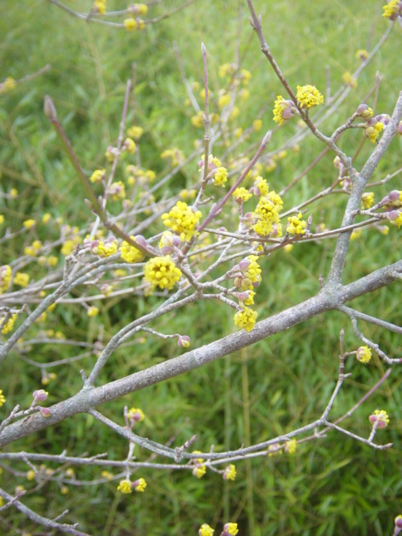
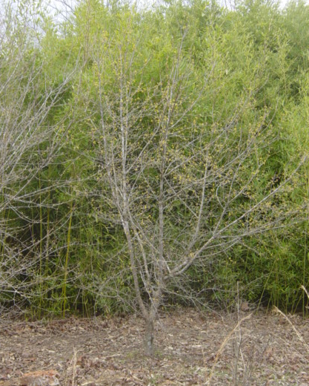
Cornelian Cherries – Cornus mas
A very edible-fruited dogwood that flowers in March/April. Healthy fruit ripens mid-summer, no pests. Important crop in Eastern Europe. Likes hot and dry locations.

Slide 14
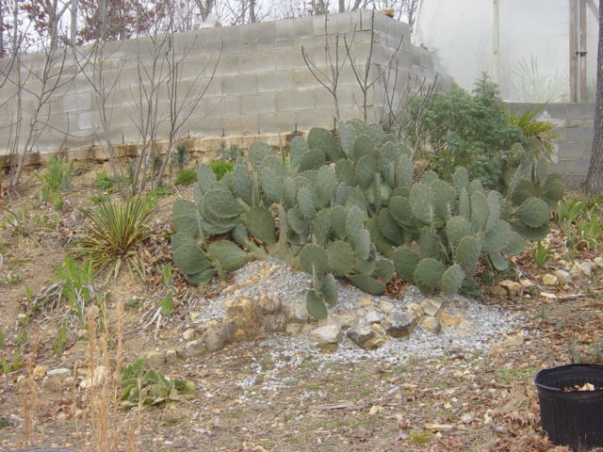
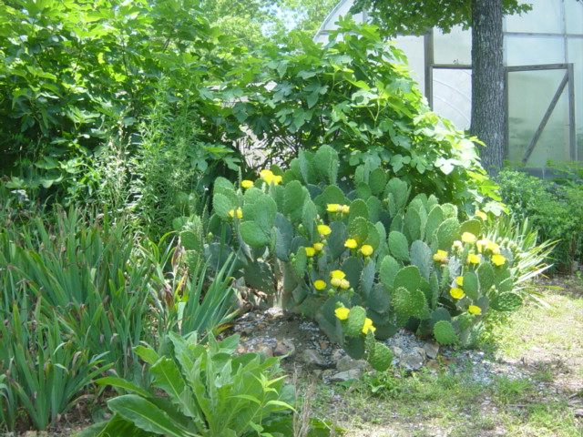
Opuntia englemanii aka Prickly Pear cactus
Both pads (nopales) and fruit (tunas) are very healthy and have the most efficient water to calories conversion of any edible plant. They didn’t like our two nights at -8°F. last winter but they came through and are recovering well. Main requirement is very good drainage. We are experimenting with 20+ species of Opuntias.

Slide 15
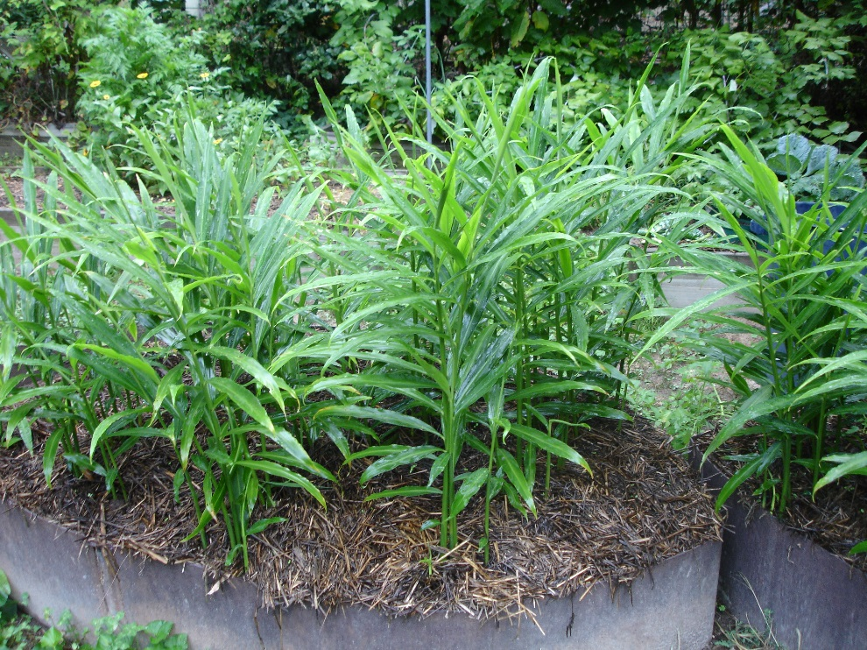
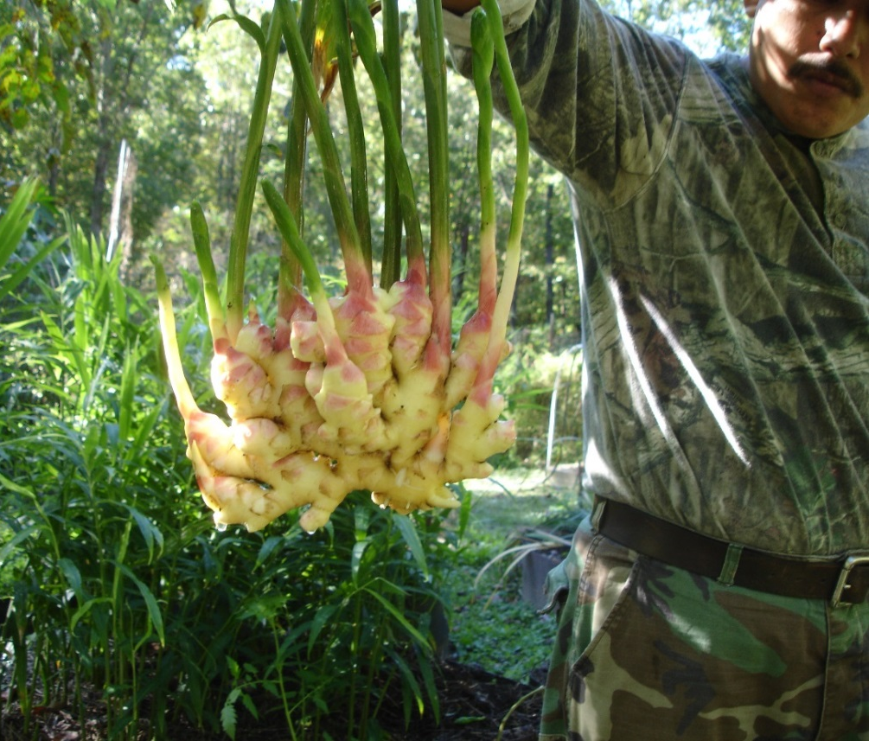
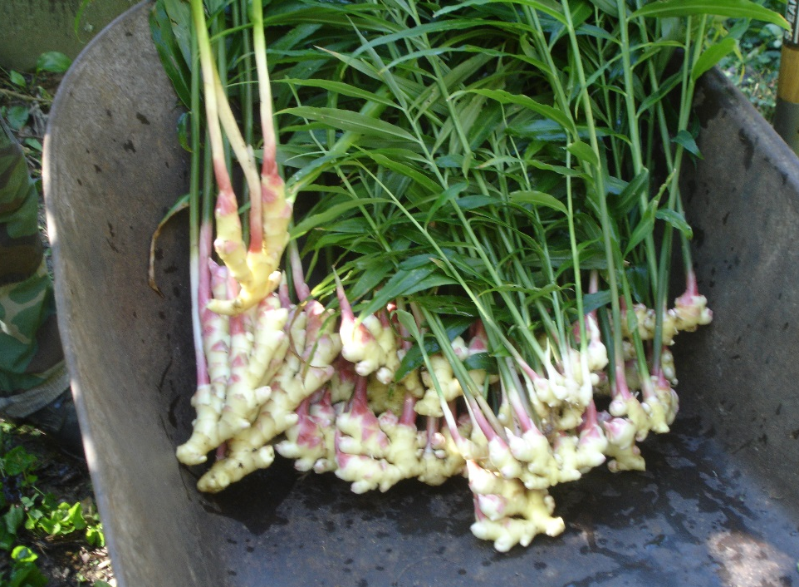
Ginger
Zingaber officionale – A long season tropical. Challenging but possible to grow here. When offered at the Franklin Farmer’s Market as fresh baby ginger, we sold out in a matter of hours.

Slide 16
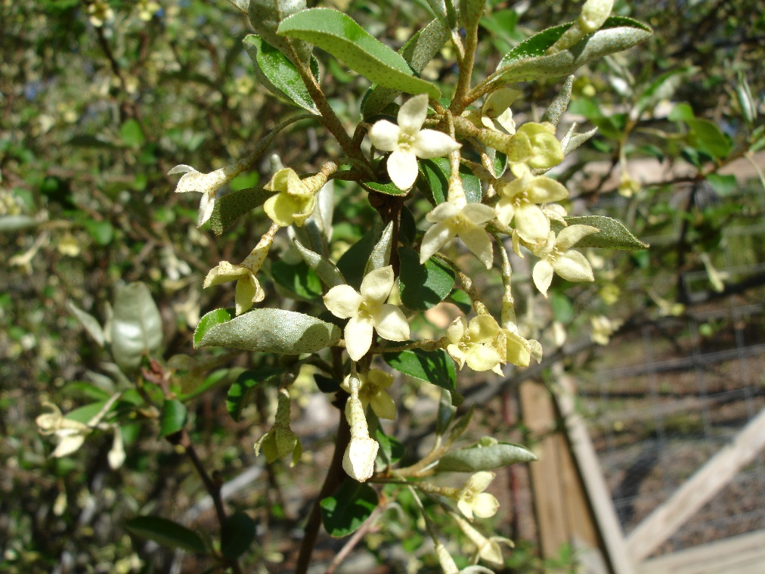
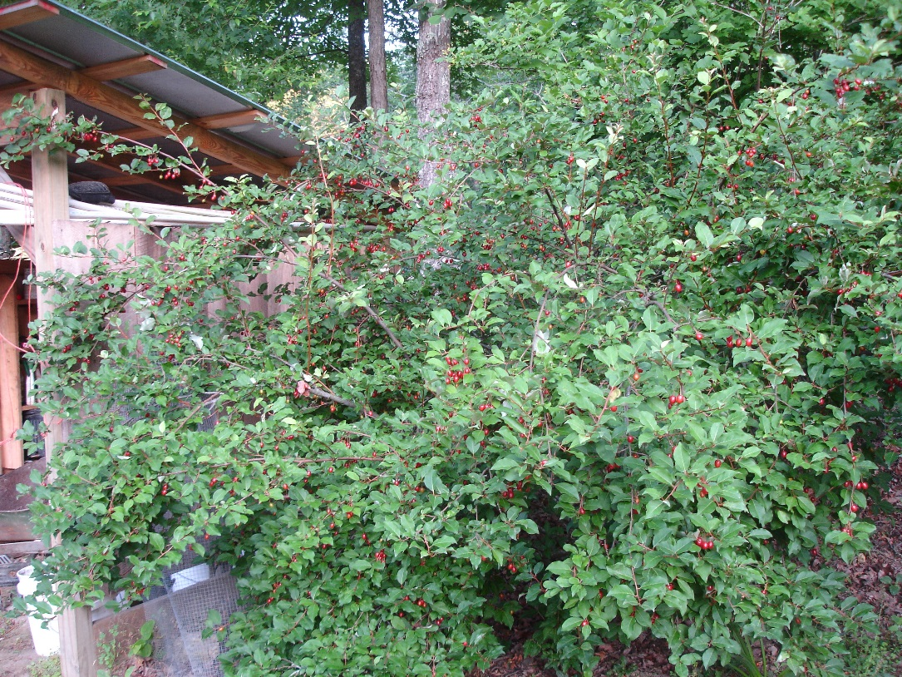
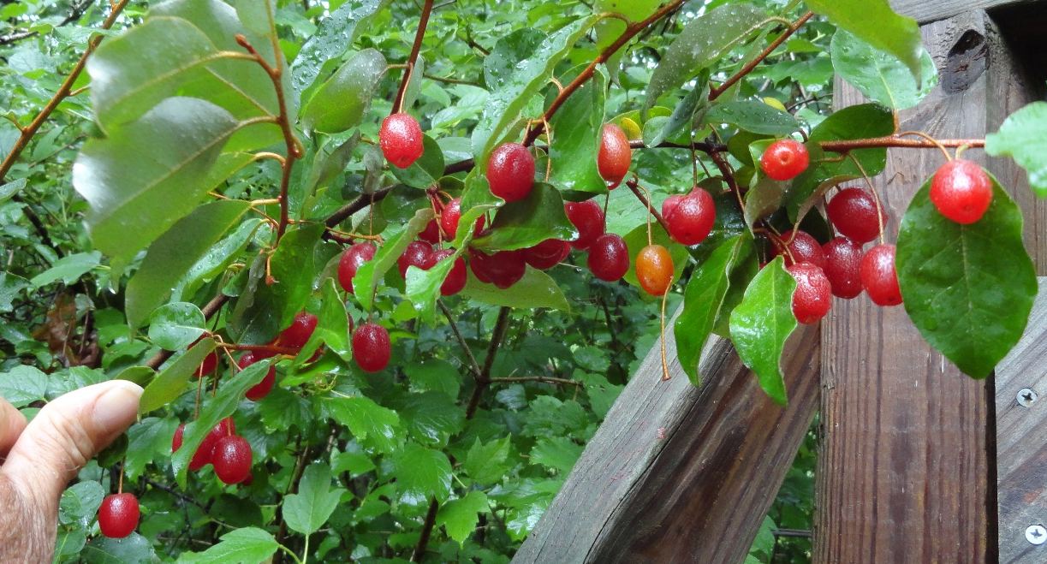
Goumi
Eleagnus multiflora
Left: Fragrant flowers are good bee pasture.
Right: abundant mid-summer fruit are healthy and delicious.
Above: nitrogen-fixing, 3 meter shrub is beautiful and builds soil.

Slide 17
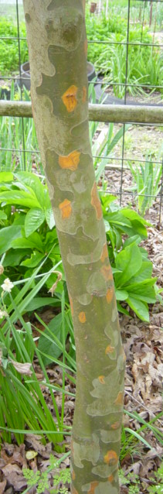
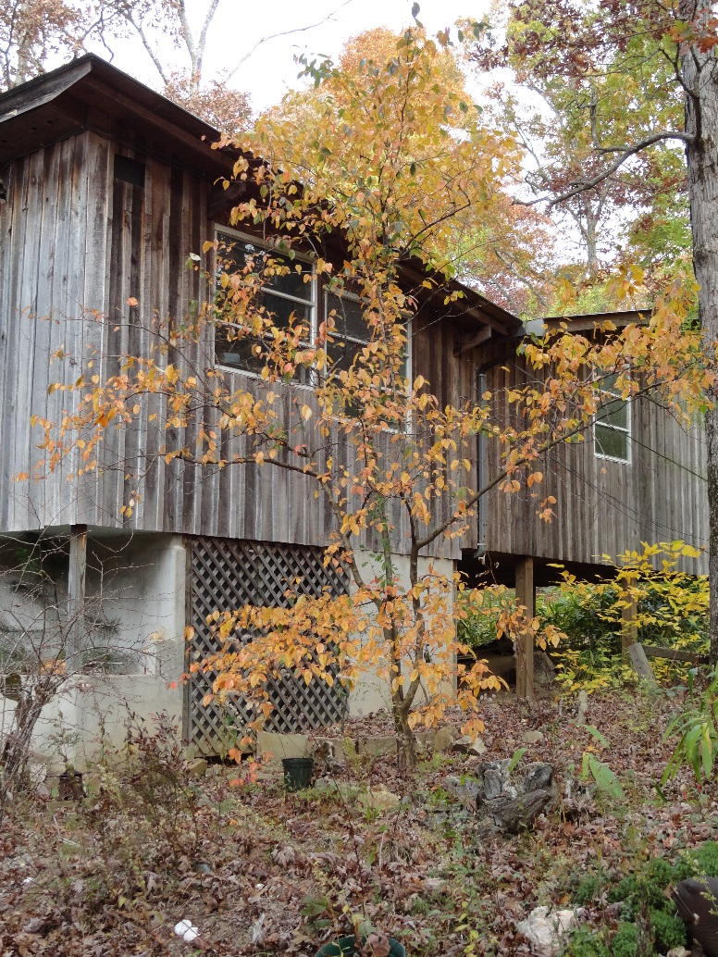
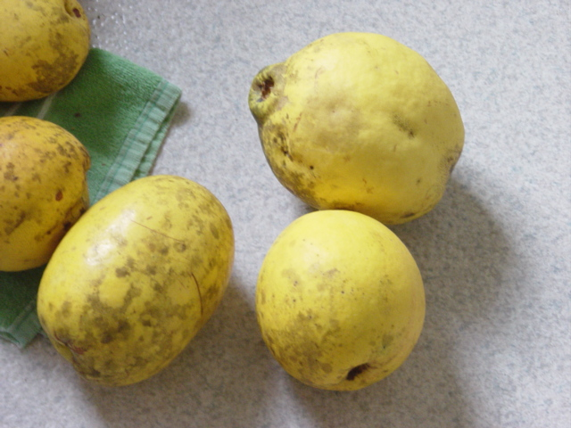
Quince – Pseudocydonia sinensis

Slide 18
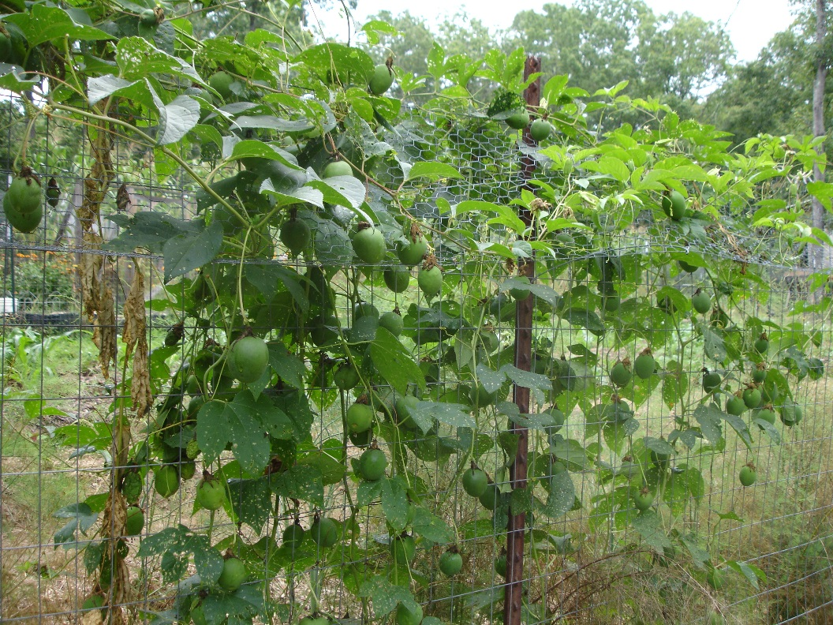
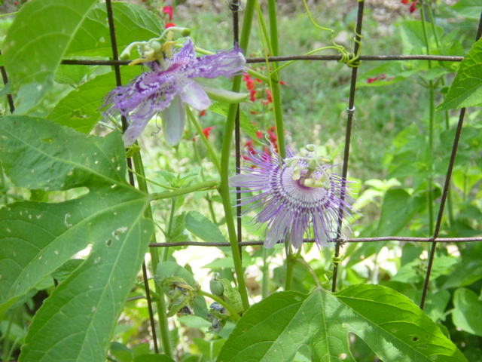
Passiflora incarnata – Maypops
Our official State Wildflower
Also, beautiful, fragrant, tasty fruit eaten fresh or made into excellent wine.

Slide 19
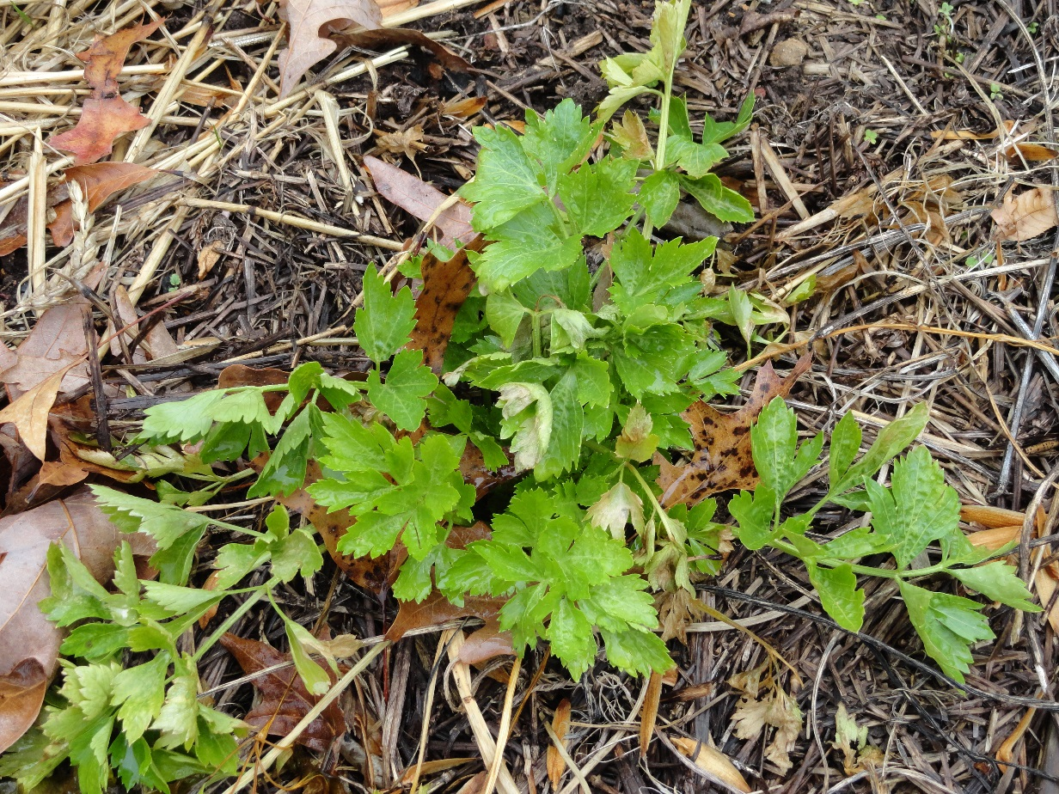
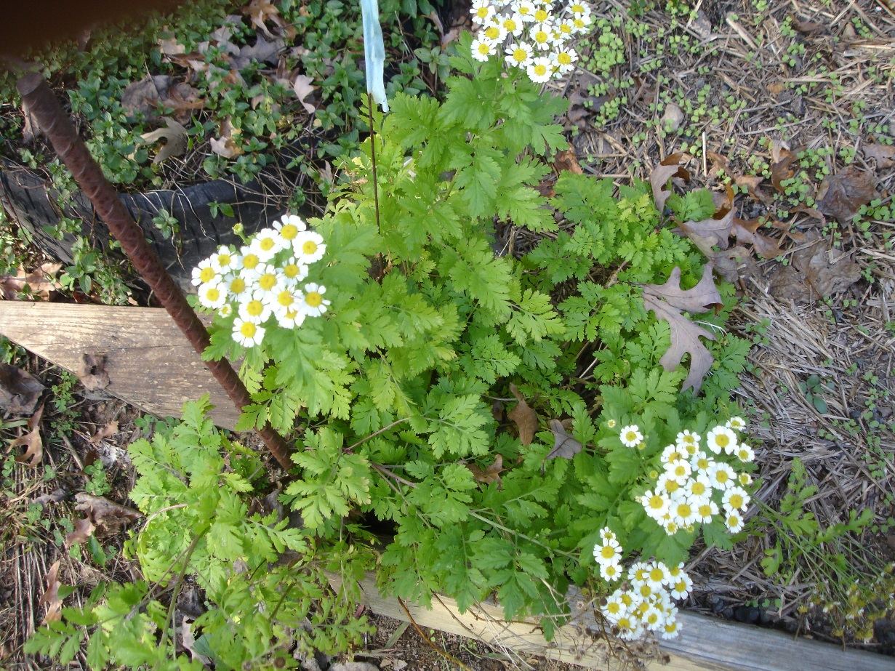
Culinary and Medicinal Herbs
Left: Cutting Celery (Apium graveolens)
Right: Feverfew (Chrysanthemum parthenium)

Slide 20
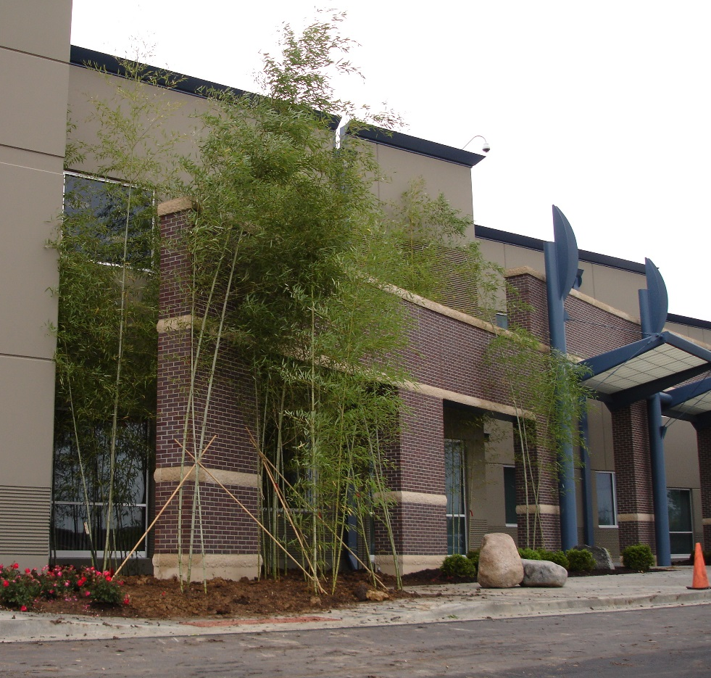
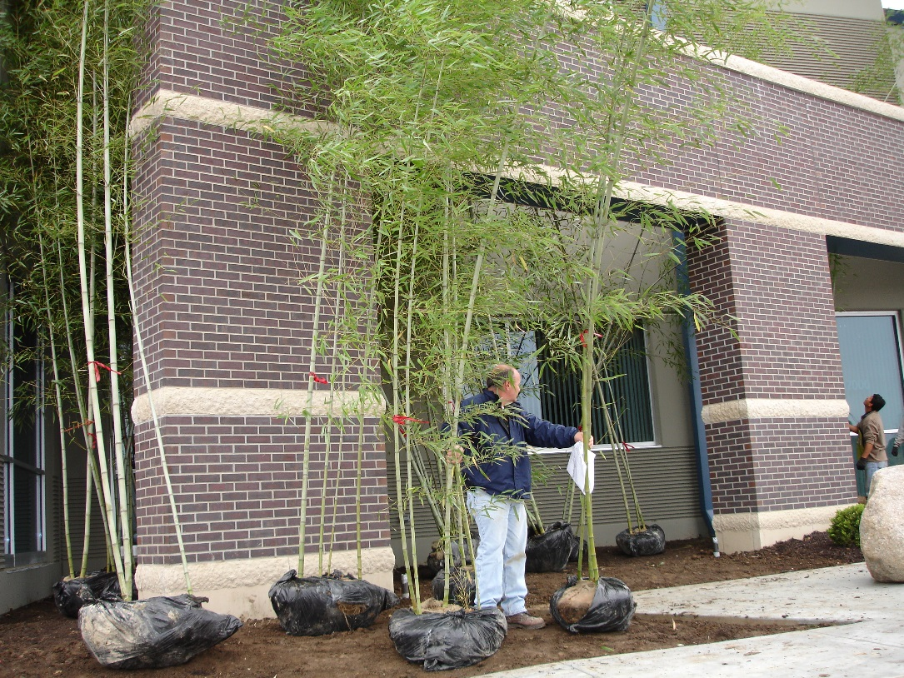
Expanding the potential range of hardy bamboos. Pictures show the use of microclimates with several cold-tolerant bamboos in Kansas City. Follow-up expands our knowledge and understanding of potential applications.

Slide 21
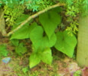
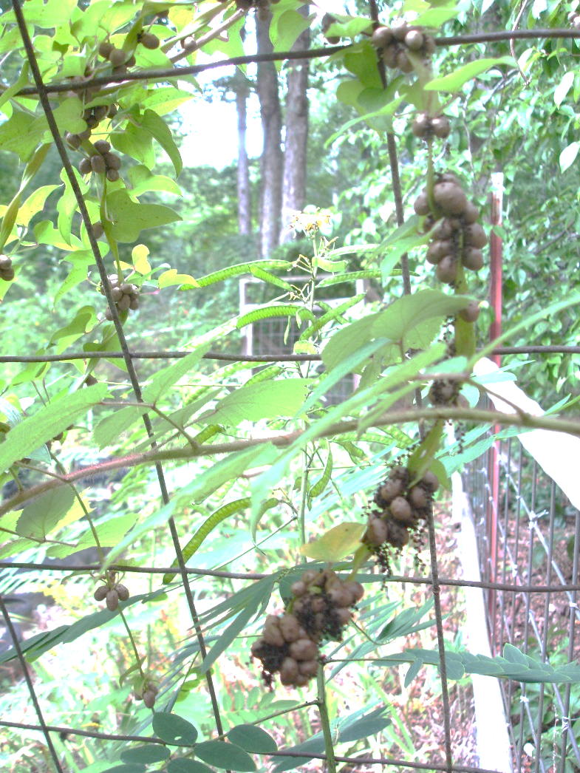
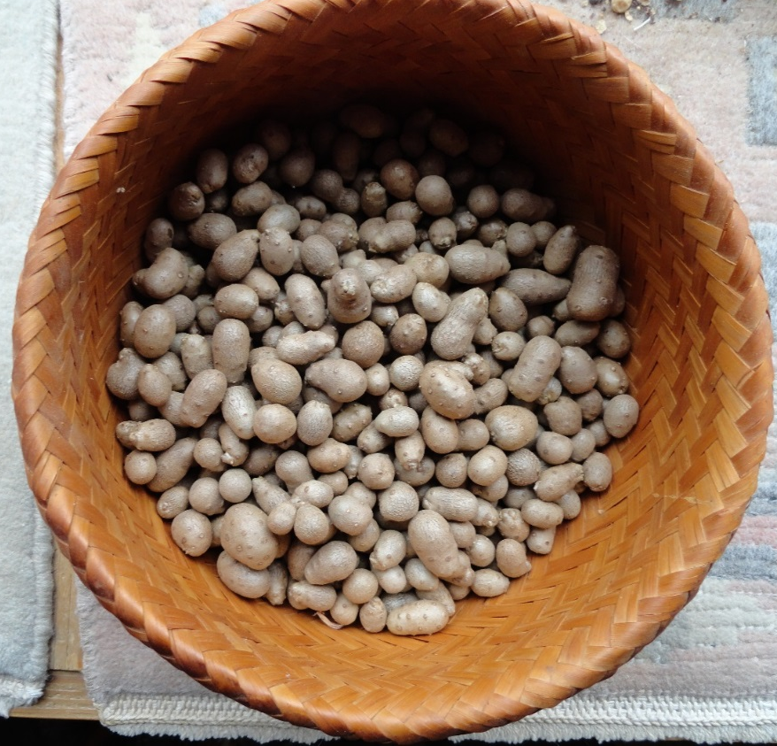
Dioscorea batatas – Air Potatoes
Hardy, perennial yam
Large underground tuber can be left for several years
Small aerial tubers produced annually at leaf axils on vine which dies back but only after leaves take on brilliant yellow color before falling.
Harvest is easiest by placing a sheet on the ground and shaking the vines.
Can be eaten raw or cooked – keeps well.

Slide 22
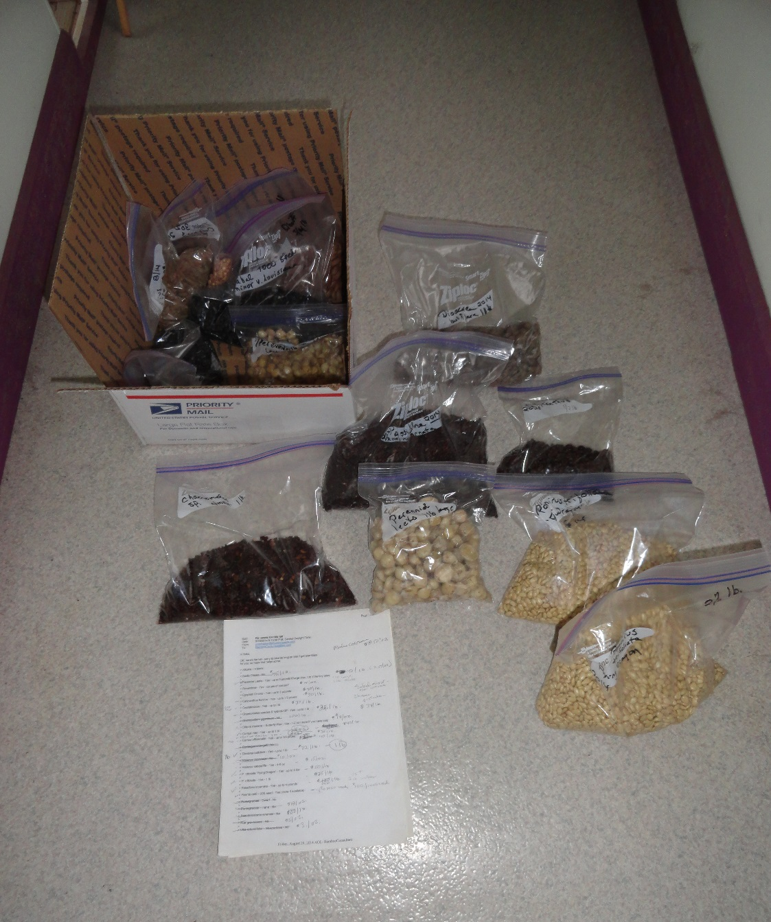
Cleaned, dried, weighed and bagged -- here various scarce seeds are ready to pack and ship to an international ethnobotanical seed house. This can be labor intensive but is great indoor work in cold or rainy weather. It not only utilizes an often discarded product of the plants but is a worthwhile addition to our economic bottom line.

Slide 23
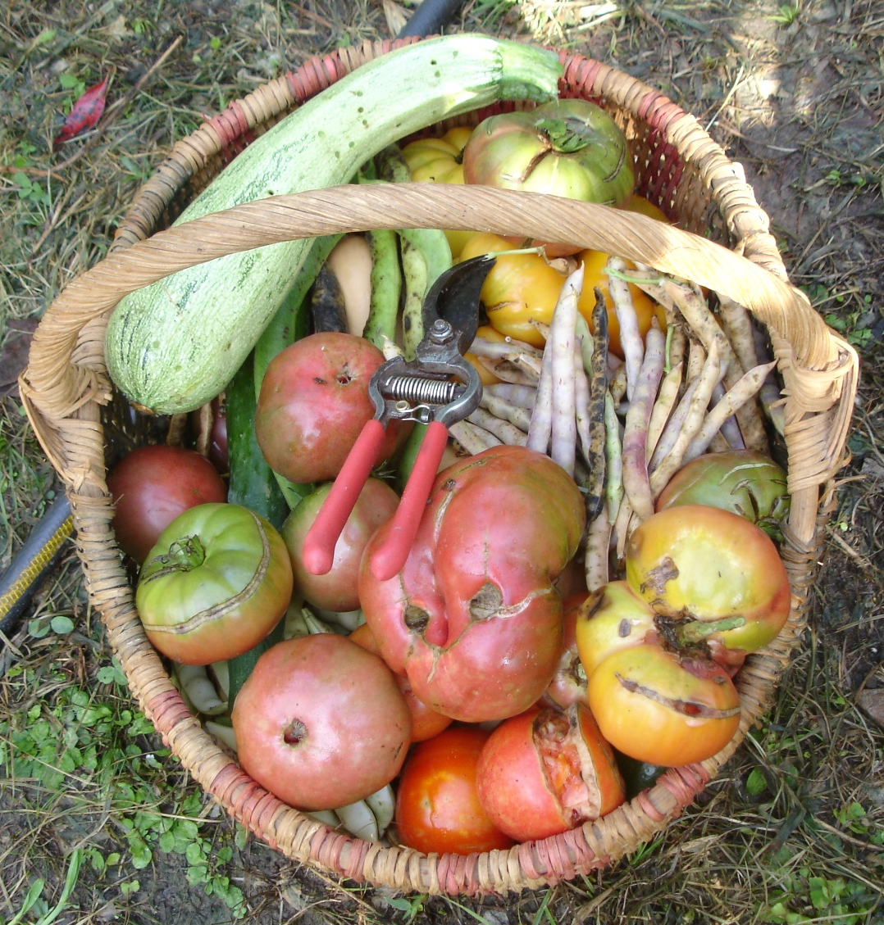
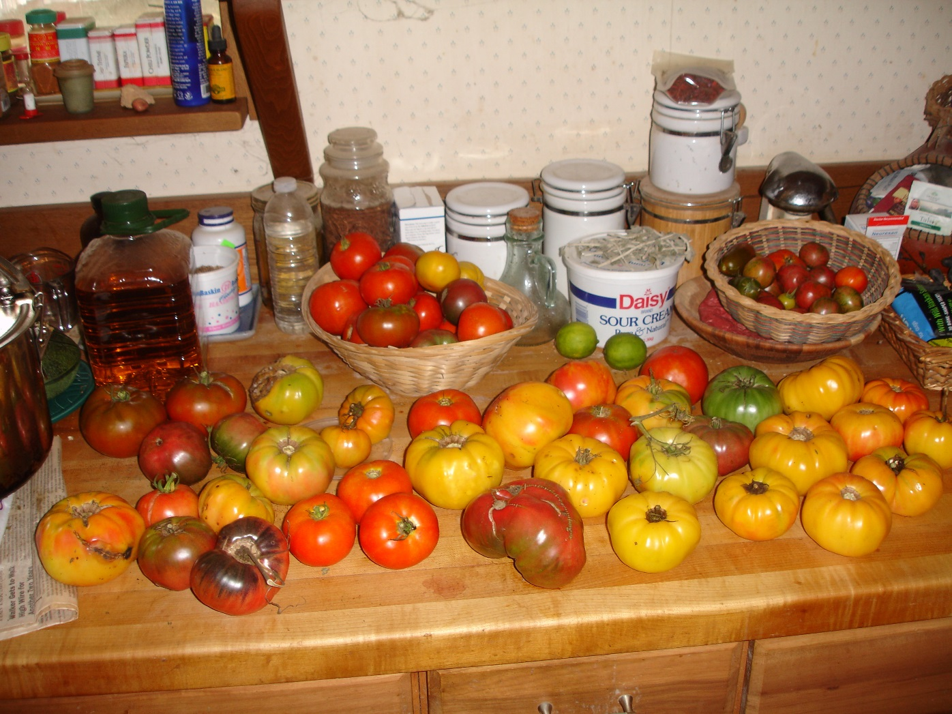
Tomatoes – some of the dozen or so cultivars that we grew this year – delicious diversity!

Slide 24
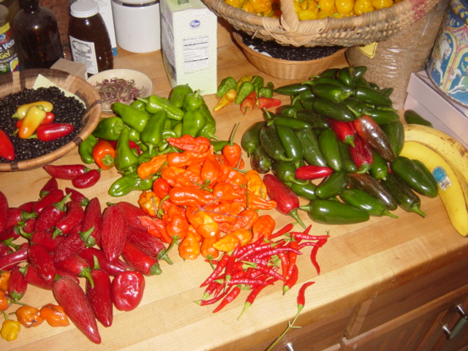
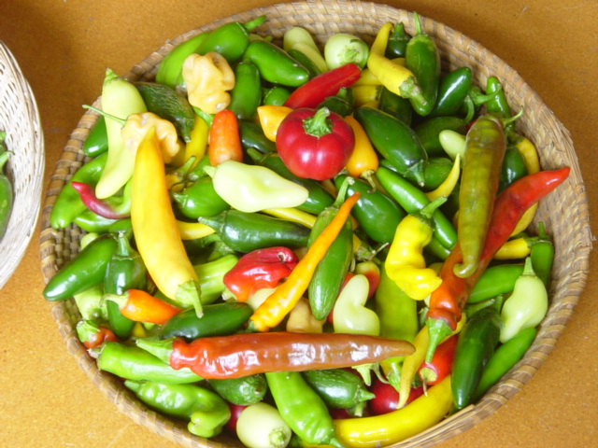
Chilies -- ditto

Slide 25
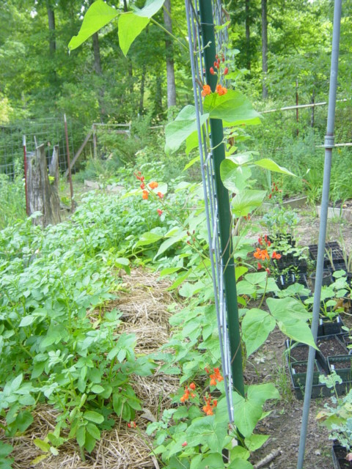
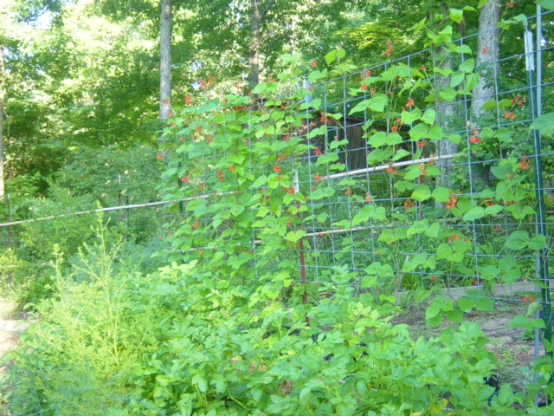
Scarlet Runner Beans
Phaeseolus coccineus
Beautiful, delicious as shelly beans and a hummingbird magnet – what’s not to like.

Slide 26
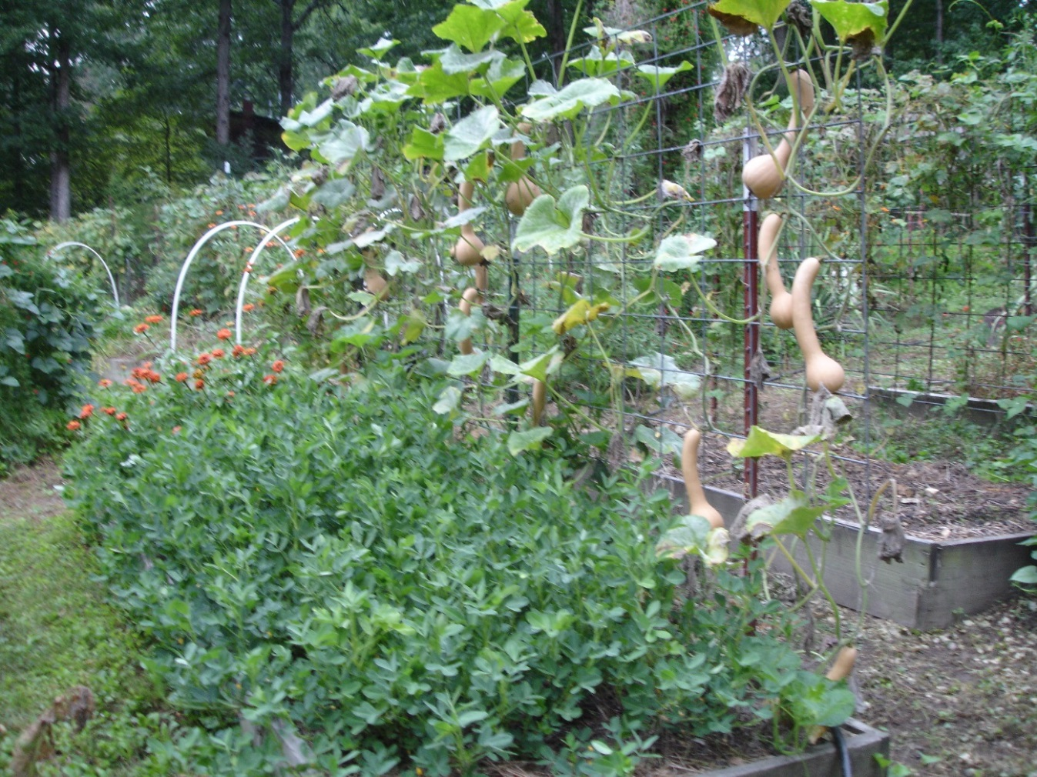
Neck or Horse Collar Winter Squash (Cucurbita moschata) – here trellised on the north side of a raised bed. Peanuts are on the flat part. Note the Zinnias at the far end of bed.
A good intercropping strategy.

Slide 27
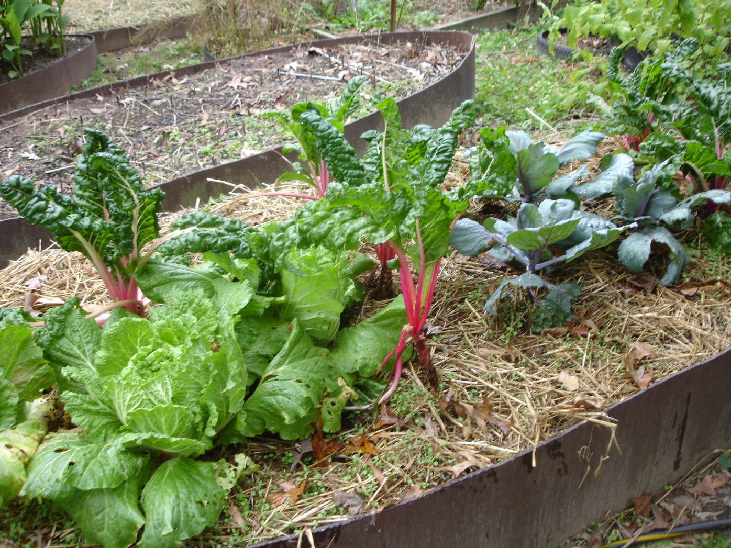
More Intercropping – here chard, chinese cabbage and a purple cabbage.

Slide 28
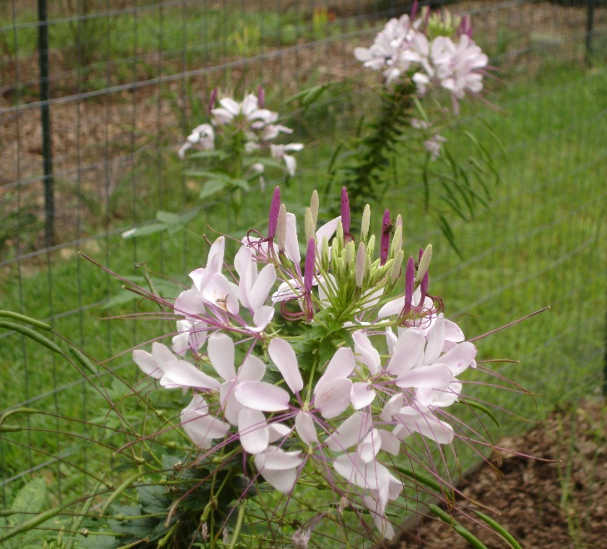
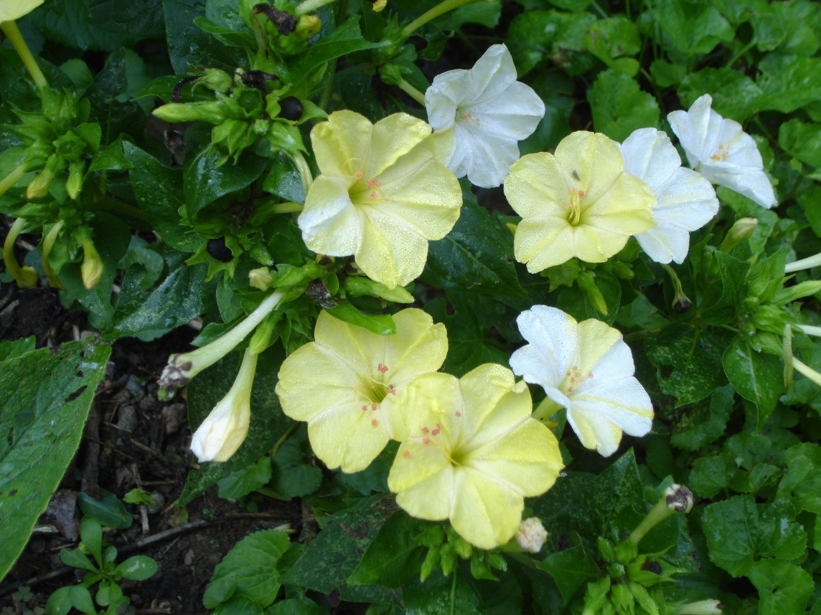

Clockwise: Cleome, Zinnias, and Four o’clocks
A few of the flowers that self seed, we move volunteers as needed.

Slide 29


Cold Frame – on the north side of our tractor shed where it stays shady in the winter. Made 30 years ago from a big piece of heavy glass from the Plexiglas factory in Crossville, Tennessee.

Slide 30


Turmeric & Palm –
Illiterate plants that don’t know they won’t grow here.
Palm – Rhapidophyllum hystrix
Turmeric – Curcuma longa

Slide 31

Catchment & Cistern
Our first building (catchment area) and original cistern (10,000 gallon capacity).
12’ diameter, 7’ in the ground made of 4” solid block and New Zealand high-tension wire compression rings.
Built in 1992.

Slide 32


Ponds, Swales, Contouring

Slide 33


A Few of our Cisterns
Converted 20’ diameter concrete silo set 12’ in the ground. Inside plastered to be watertight. Connected to underground piping to chicken yard, and various greenhouses and gardens.
8’ diameter old steel underground gasoline tank repurposed as a cistern. Capacity around 3,000 gallons. Note the pvc aquaduct bringing water from our dwelling house roof.

Slide 34

Rabbits – prefer hay or fresh greens. Here – sweet potato greens. Excellent feed conversion. Notably bigger and meatier than cottontails.

Slide 35

Chickens – we are still trying new breeds to identify those that best integrate to our situation. Shown here the black ones are Jersey Giants, the gray speckled ones are Dominique's, the brown ones with sideburns are Orloffs and there are few others.

Slide 36

Franklin Farmer’s Market
Booth

Slide 37
Plant something today
… and tomorrow
… and the next day
… as long as you can
www.earthadvocatesresearchfarm.com

